Slide 1
Finite elements simulations of surface protrusion evolution due to spherical voids in the metals
University of Tartu:
V. Zadin
A. Aabloo
University of Helsinki:
A. Pohjonen
S. Parviainen
F. Djurabekova
CERN:
W. Wuench
M. Aicheler
2013

Slide 2
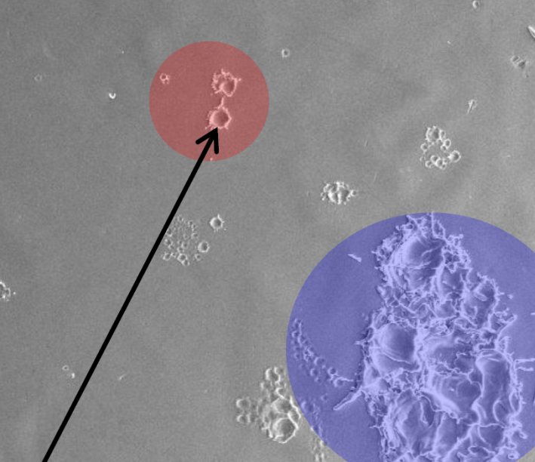
Electrical breakdowns
Electrical breakdowns at CLIC accelerator accelerating structure materials
Accelerating el. field 100-150 MV/m
Accelerating structure damage due to electrical breakdowns
Local field enhancement up to factor 100
Field enhancement caused by „invisible needles“
M. Aicheler, MeVArc 2011
Electrical breakdown rate must be decreased under 3⋅10⁻⁷ 1/pulse/m
Voids in the material as possible factors affecting surface defects

Slide 3
Void hypothesis
Mechanism behind field emitting tip generation
Void in material as stress concentrators
Spherical voids due to surface energy minimization
Single void in metal
Several mechanisms acting at once to produce the tip?
Understanding protrusion growth mechanism in the case of spherical void in DC electrical field
Soft copper
Single crystal copper
Stainless steel

Slide 4
Computer simulations in Chemistry and Physics
Time
years
Finite Element Analysis
seconds
Mesoscale modeling
microsec
Molecular dynamics
nanosec
picosec
DFT
femtosec
1Å
1nm
10nm
1μm
1mm
Distance

Slide 5
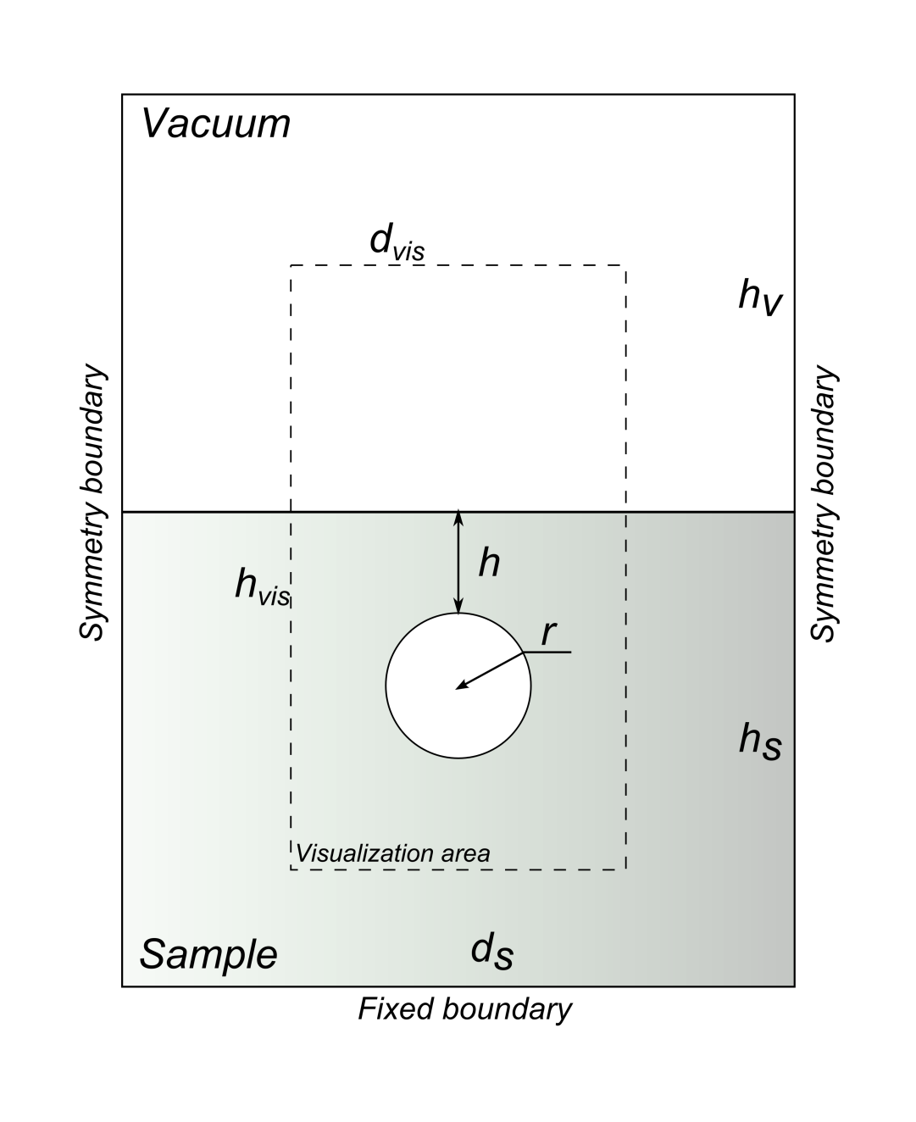
Simulated system
Fully coupled electric field – mechanical interaction
Electric field deforms sample
Deformed sample causes local field enhancement
Dc El. field ramped from 0 … 10 000 MV/m
Comsol Multiphysics 4.3
Nonlinear Structural Materials Module
AC/DC module
3D-simulations, 2D-snapshots
Simulated materials:
Soft copper
Single crystal copper
Stainless steel

Slide 6
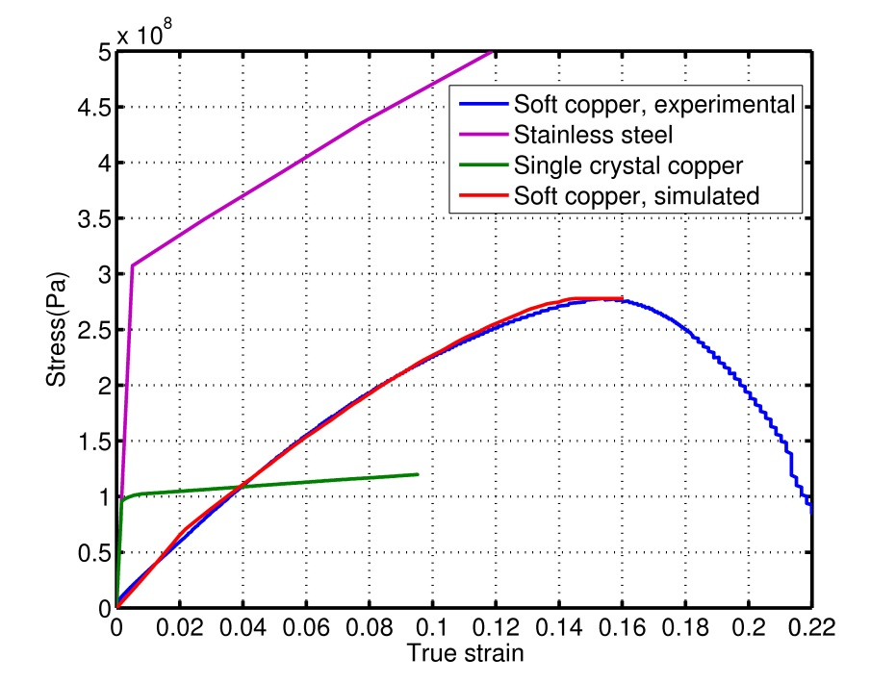
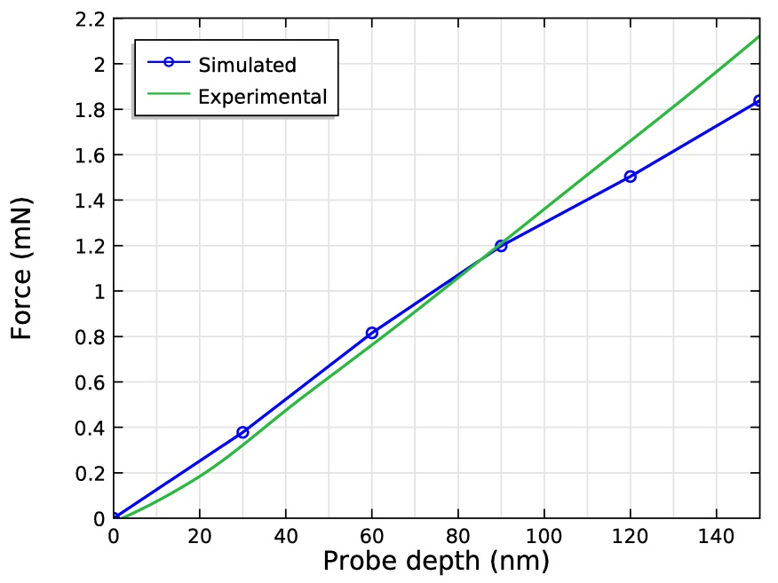
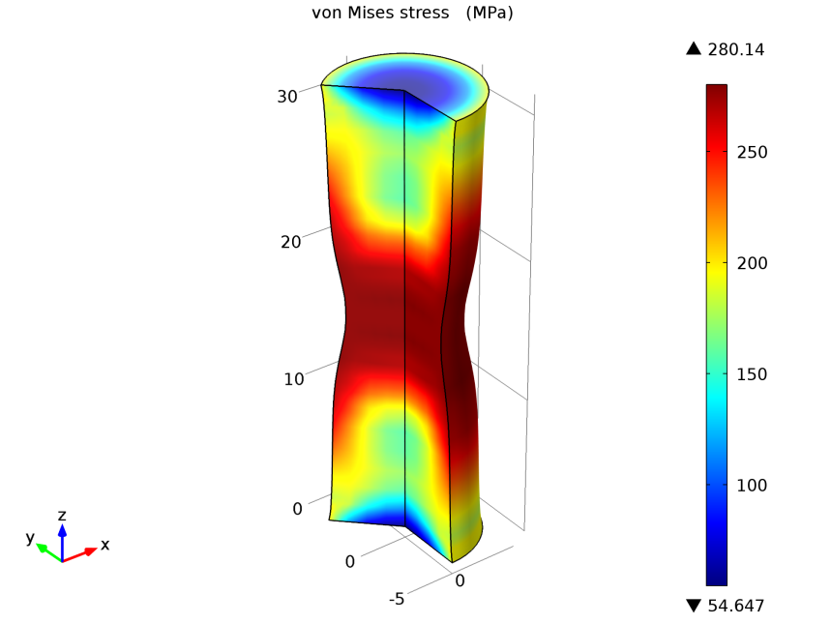
Material model
Elastoplastic deformation of material, simulation of large strains
Validation of material model and parameters by conducting tensile stress simulations
Accurate duplication of the experimental results (tensile and nanoindentation test)
Parameters from tensile test are macroscopic, single crystal parameters are needed due to large grains in soft copper
 | Structural Steel | Soft Copper (CERN) | Single crystal copper [1] | Often used copper parameters
Young’s modulus | 200 GPa | 3.05 GPa | 57 GPa | 110 GPa
Initial yield stress | 290 MPa | 68 MPa | 98 MPa | 70 MPa
[1] Y. Liu, B. Wang, M. Yoshino, S. Roy, H. Lu, R. Komanduri,J. Mech. Phys. Solids, 53 (2005) 2718

Slide 7
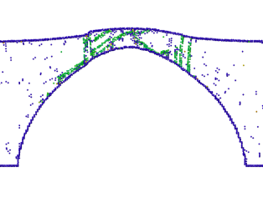
MD vs FEM
MD – exaggerated el. fields are needed
MD simulations are accurate, but time consuming
FEM is computationally fast, but limited at atomistic scale
Very similar protrusion shape
Material deformation starts in same region

Slide 8
Void at max. deformation – different materials
Stainless Steel
Single crystal Cu
Soft Cu
Similar protrusion shape for all materials
Higher el. fields are needed to deform stronger materials
Slightly different maximum stress regions
Plastic deformation distribution highly dependent from material

Slide 9
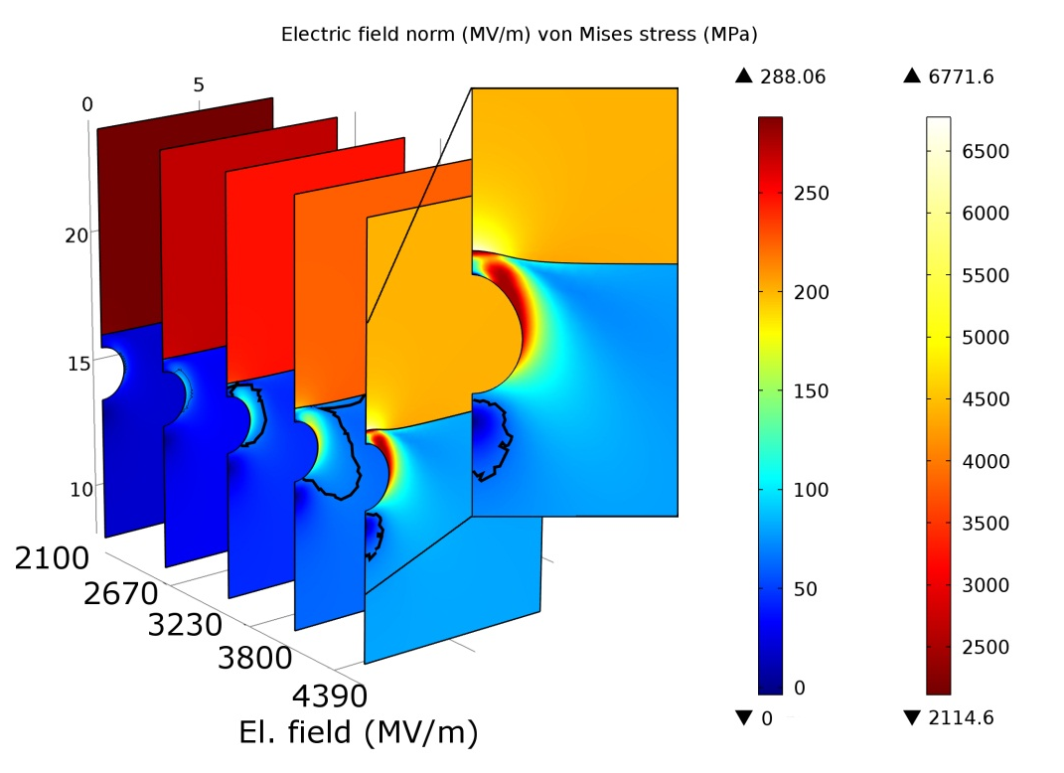
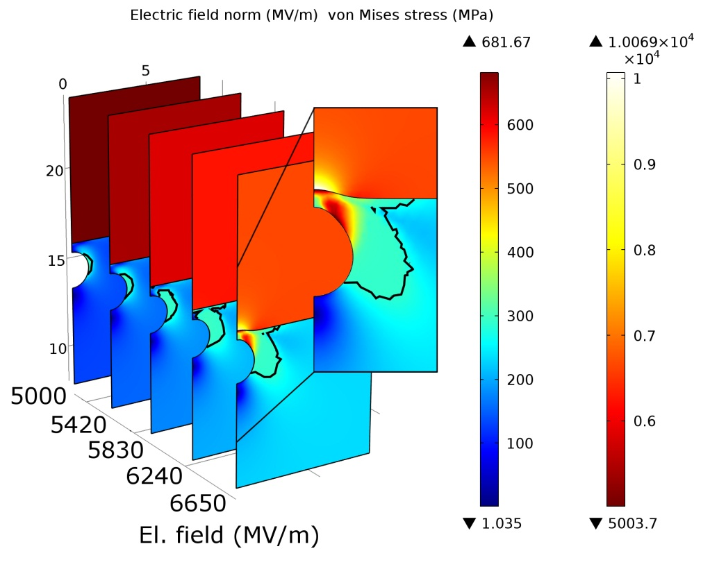
Protrusion formation
Scale invariance – larger voids produce only larger protrusions
Well defined protrusion evolves on the steel surface
Low protrusion evolves on the soft copper surface
Protrusion formation on copper surface requires ~2 times lower el. field
Protrusion formation starts after material becomes plastic
Soft Cu
Steel
Soft copper is „harder“ to deform
Material hardening around the void
Nearby material deformation due to low Young’s modulus
Over 2000 MV/m is required to initiate any significant protrusion formation in soft copper

Slide 10
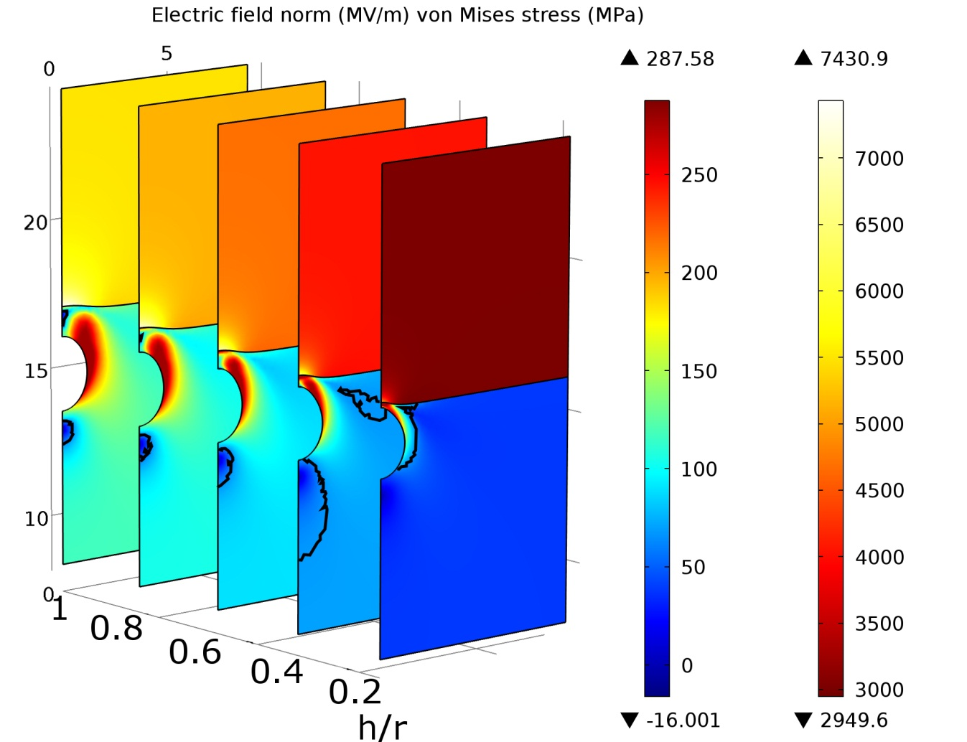
Protrusion formation at different depths
Close to surface void needs smallest el. field for deformation
Max. stress for near surface voids is concentrate between void and sample surface
Max. stress distribution moves to the sides of void by increasing depth
Deeper voids cause whole material to deform plastically
Soft Cu

Slide 11
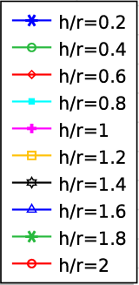
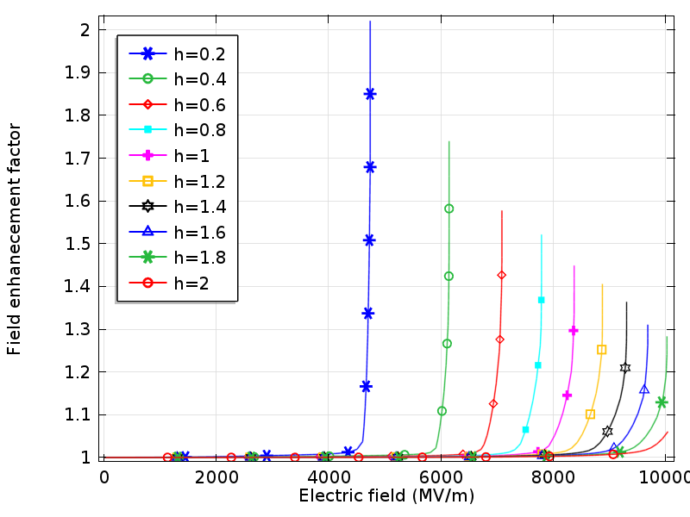
Field enhancement factor
Field enhancement factor to characterize protrusions shape
Soft copper
Elastic deformation affects field enhancement
Field enhancement increasing over whole el. field range
Field enhancement is continuous and smooth
Stainless steel, single crystal Cu
Field enhancement almost constant until critical field value
Very fast increase of the field enhancement factor
Maximum field enhancement is 2 times
Field enhancement corresponds to protrusion growth
Soft Cu
Steel

Slide 12
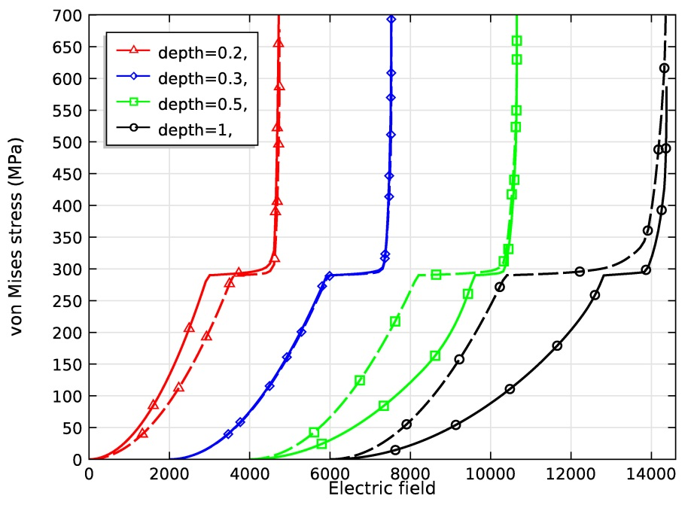
Surface stress distribution
Soft copper
Continuous stress increase on void and surface
Stainless steel
Plateau at yield strength
Material hardening and further plastic deformation
Mayor differences in stress due to Young modulus
Low Young modulus avoids sudden jumps in field enhancement
Deformation mechanism changes at depth~0.3
Soft Cu
h/r= 0.2
h/r= 0.3
h/r= 0.5
h/r= 1
Steel
Electric field

Slide 13
Yield point
Nonlinear dependence from the void depth
For h/r<0.3, yielding starts at void tip
For h/r=0.3, yielding equal at tip and sides
For h/r>0.3, stress is carried to the sides of the void
Three deformation mechanisms
Deformation at metal surface
Deformation at void surface
Deformation due to decreased surface area
Too deep void starts to decrease the effective surface area of the sample
h/r=0.2
Steel
Single crystal copper
Soft copper

Slide 14
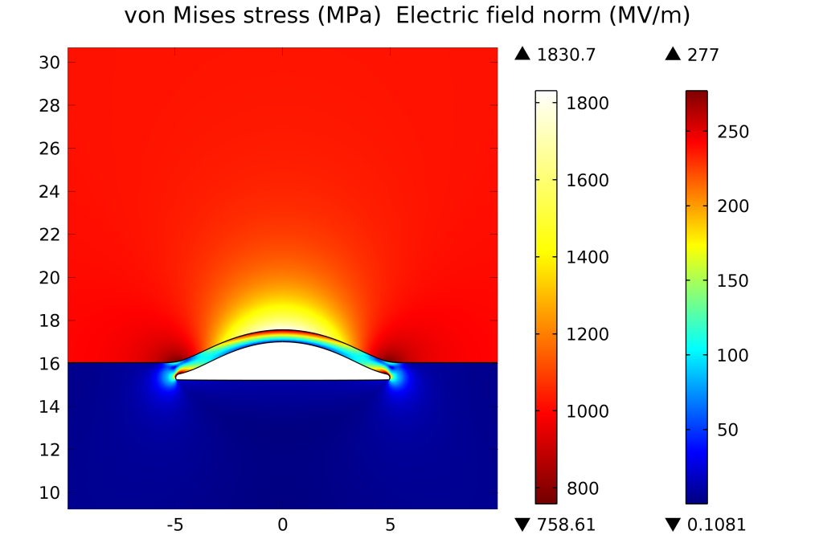
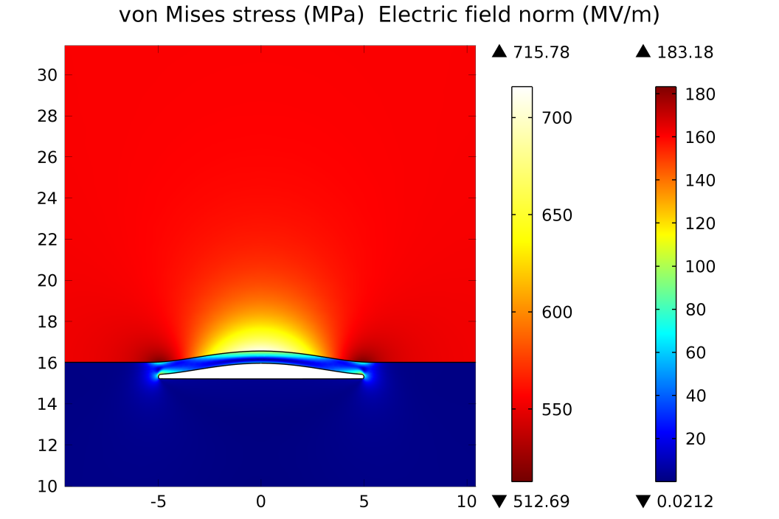
Deformation at realistic electric field strength
Void formation starts at fields > 400 MV/m
Material is plastic only in the vicinity of the defect
Thin slit may be formed by combination of voids or by a layer of fragile impurities
Field enhancement factor ~2.4
Thin material layer over the void acts like a lever, decreasing the pressure needed for protrusion formation

Slide 15
Conclusions
FEM is a viable too to simulate material defects
MD is still needed to determine physics behind the effects
Protrusion shape is similar for all simulated materials
Material deformation starts after exceeding yield strength
Field enhancement corresponds to protrusion growth
Three protrusion generation mechanisms
Deformation mechanisms change at h/r~0.3 and h/r~ 1
Too deep void starts to decrease the effective surface area of the sample
Single void needs too high el. field to produce a protrusion

Slide 16
Thank You for Your attention!

