Slide 1
Basic physics experiments for benefit of cancer research: research on materials for linear accelarators in CERN
University of Tartu:
V. Zadin
A. Aabloo
University of Helsinki:
A. Pohjonen
S. Parviainen
F. Djurabekova
CERN:
W. Wuench
M. Aicheler
IMS Lab
2013

Slide 2
Outline
What is a linear accelerator and CLIC
Electrical breakdowns
Multiscale material simulations
Medical applications of linear accelerators

Slide 3
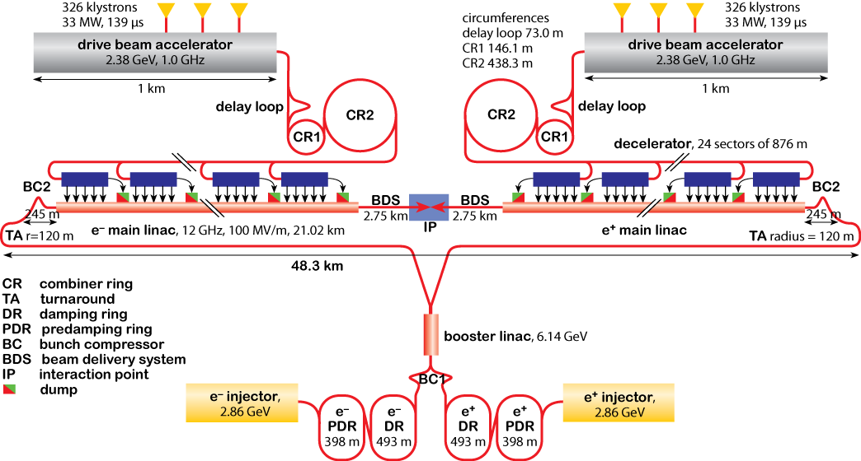
Compact Linear Collider
Two-beam-acceleration concept: The 12 GHz RF power is generated by a high current electron beam (drive beam) running parallel to the main beam.
Drive beam is decelerated in special power extraction structures (PETS) and the generated RF power is transferred to the main beam.
This leads to a very simple tunnel layout without any active RF components
Physics beyond the standard model
Precise measurements of Higgs boson
Investigation of exotic Higgs interactions
Very „clean“ environment

Slide 4
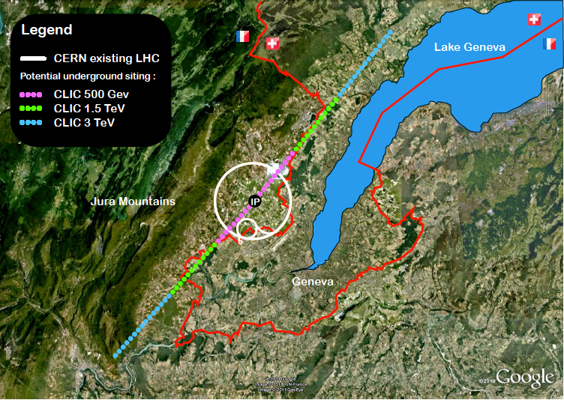
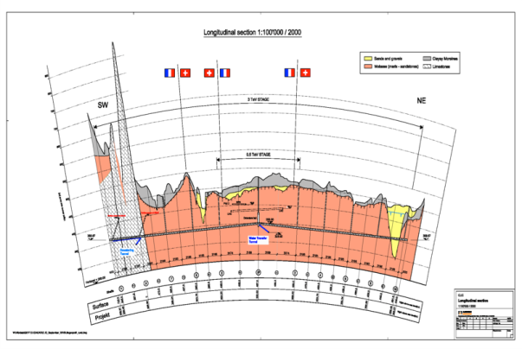
CLIC near CERN
Tunnel implementations (laser straight)
Central MDI & Interaction Region

Slide 5
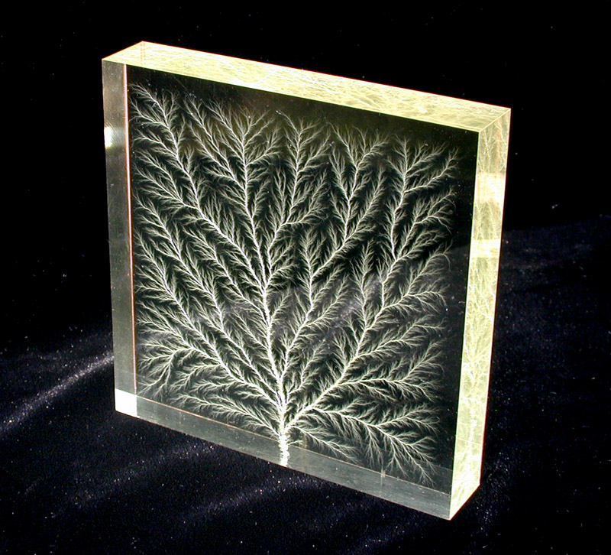
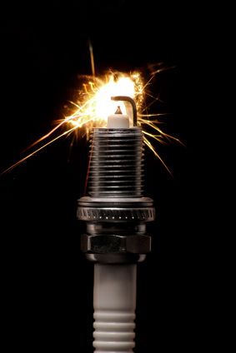
Electrical breakdown

Slide 6
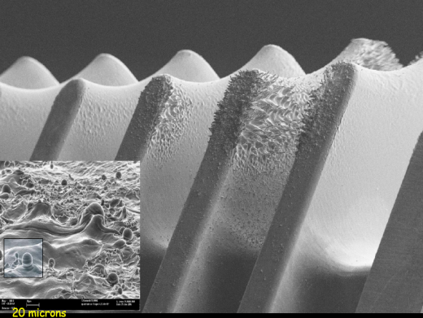
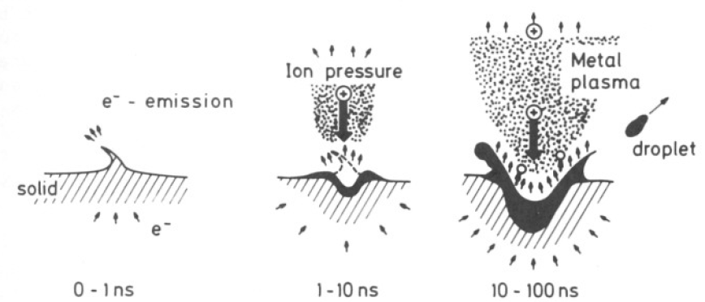
Electrical breakdowns in CLIC
Electrical breakdowns at CLIC accelerator accelerating structure materials
Accelerating el. field 100-150 MV/m
Accelerating structure damage due to electrical breakdowns
Local field enhancement up to factor 100
Field enhancement caused by „invisible needles“
Highest RF field gradient
R. Behrisch, Plenum, 1986
B. Jüttner, 1979
Electrical breakdown rate must be decerased under 3⋅10⁻⁷ 1/pulse/m
Voids in the material as possible factors affecting surface defects

Slide 7
SEM analysis
A. Degiovanni CLIC Workshop 2013

Slide 8
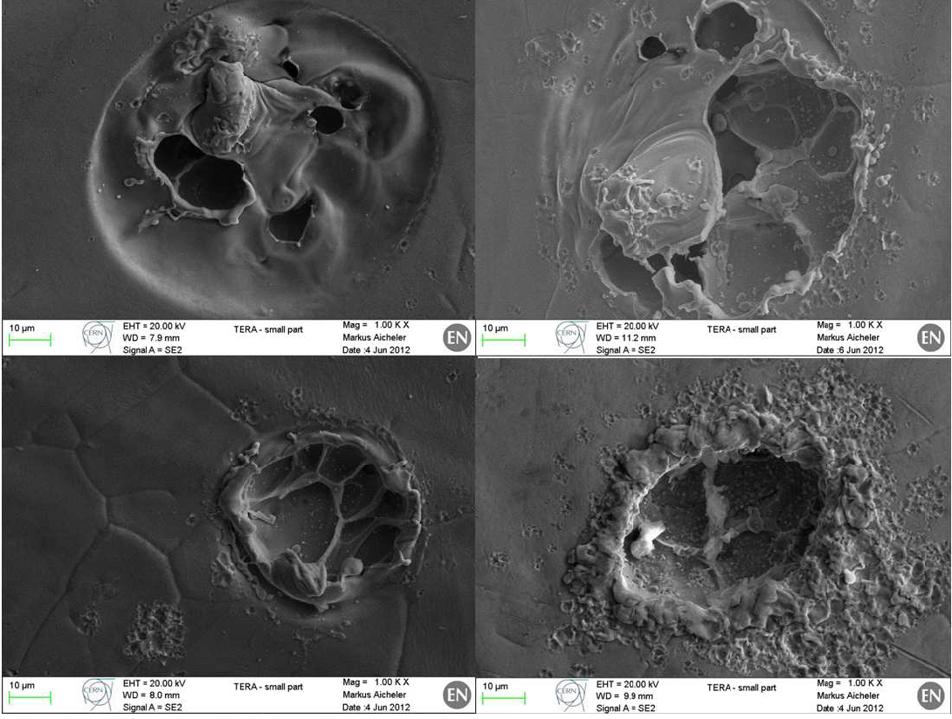
A. Degiovanni CLIC Workshop 2013

Slide 9
surface depressions which can be the precursors of the bubble-like craters
projection of molten copper
burst bubble
A. Degiovanni CLIC Workshop 2013

Slide 10
Computer simulations in Chemistry and Physics
Time
years
Finite Element Analysis
seconds
Mesoscale modeling
microsec
Molecular dynamics
nanosec
picosec
DFT
femtosec
1Å
1nm
10nm
1μm
1mm
Distance

Slide 11
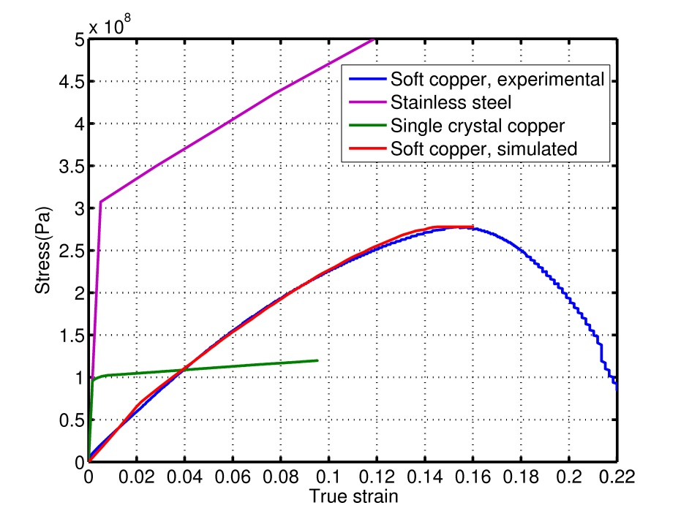
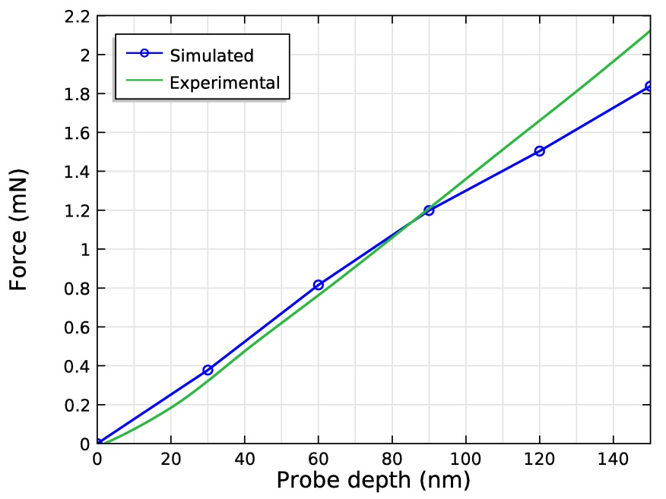
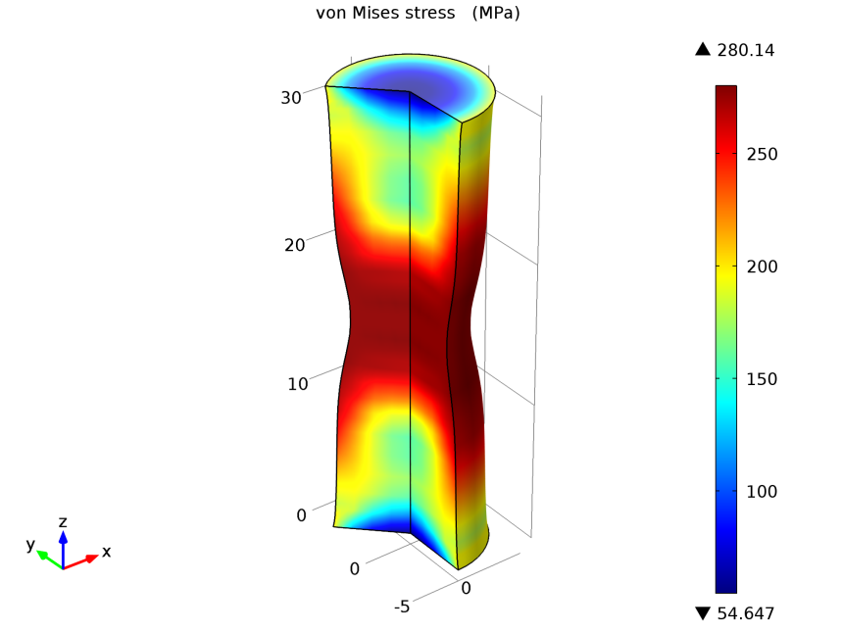
Material model
Elastoplastic deformation of material, simulation of large strains
Validation of material model and parameters by conducting tensile stress simulations
Accurate duplication of the experimental results (tensile and nanoindentation test)
Parameters from tensile test are macroscopic, single crystal parameters are needed due to large grains in soft copper
 | Structural Steel | Soft Copper (CERN) | Single crystal copper [1] | Often used copper parameters
Young’s modulus | 200 GPa | 3.05 GPa | 57 GPa | 110 GPa
Initial yield stress | 290 MPa | 68 MPa | 98 MPa | 70 MPa
[1] Y. Liu, B. Wang, M. Yoshino, S. Roy, H. Lu, R. Komanduri,J. Mech. Phys. Solids, 53 (2005) 2718

Slide 12
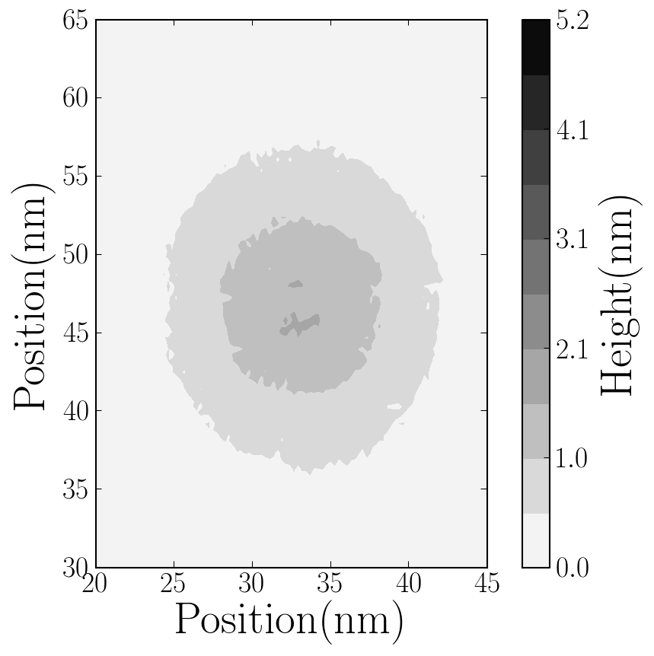
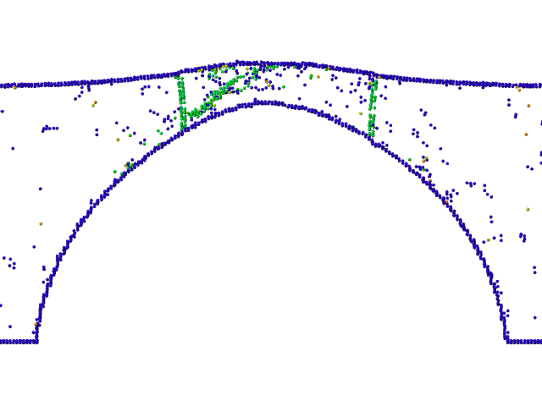
Initial plastic deformation
the top view and a slice of the system at time t = 114 ps when the first bump has formed

Slide 13
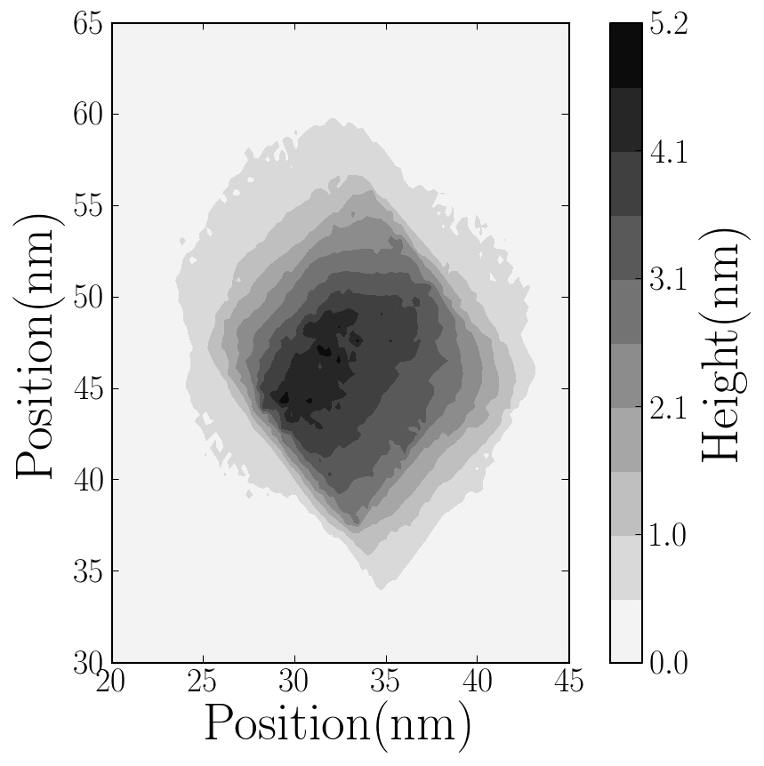
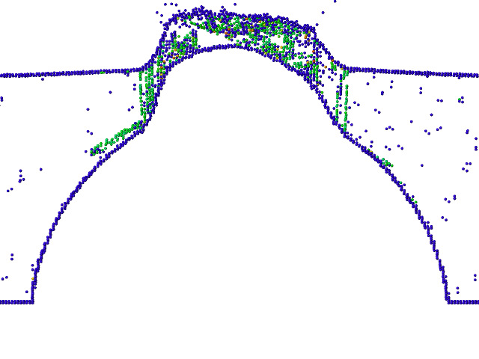
“Catastrophic”growth of a protrusion at the void
the top view and a slice of the system at time t = 130 ps when the fully developed protrusion is clearly visible.

Slide 14
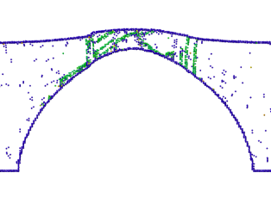
MD vs FEM
MD – exaggerated el. fields are needed
MD simulations are accurate, but time consuming
FEM is computationally fast, but limited at atomistic scale
Very similar protrusion shape
Material deformation starts in same region

Slide 15
Void at max. deformation – different materials
Stainless Steel
Single crystal Cu
Soft Cu
Similar protrusion shape for all materials
Higher el. fields are needed to deform stronger materials
Slightly different maximum stress regions
Plastic deformation distribution highly dependent from material

Slide 16
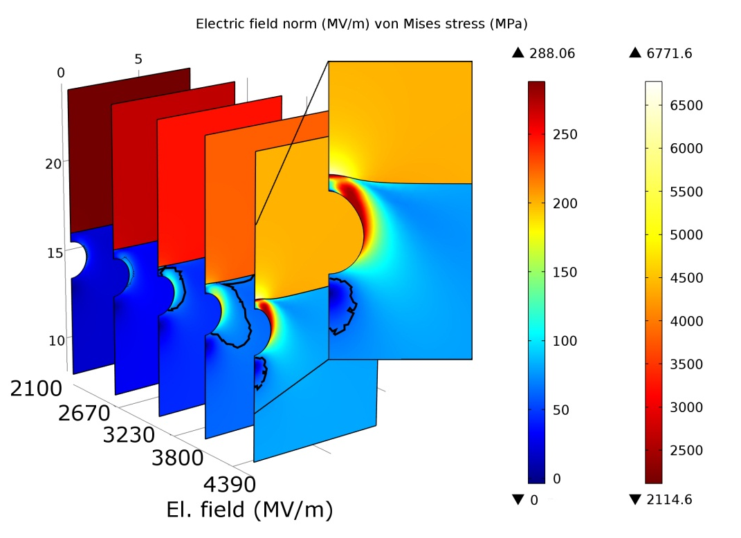
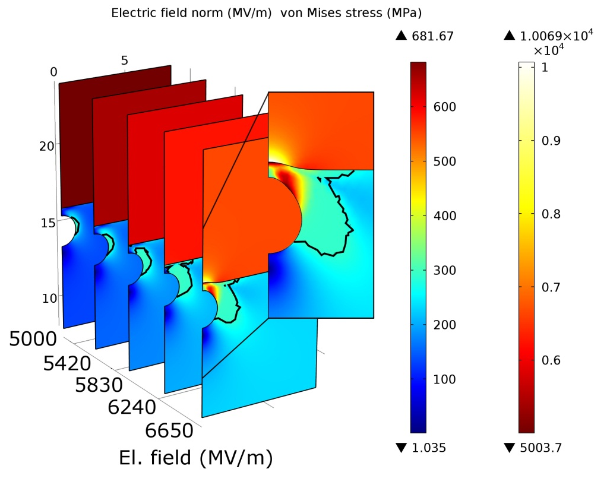
Protrusion formation
Scale invariance – larger voids produce only larger protrusions
Well defined protrusion evolves on the steel surface
Low protrusion evolves on the soft copper surface
Protrusion formation on copper surface requires ~2 times lower el. field
Protrusion formation starts after material becomes plastic
Soft Cu
Steel
Soft copper is „harder“ to deform
Material hardening around the void
Nearby material deformation due to low Young modulus
Over 2000 MV/m is required to initiate any significant protrusion formation in soft copper

Slide 17
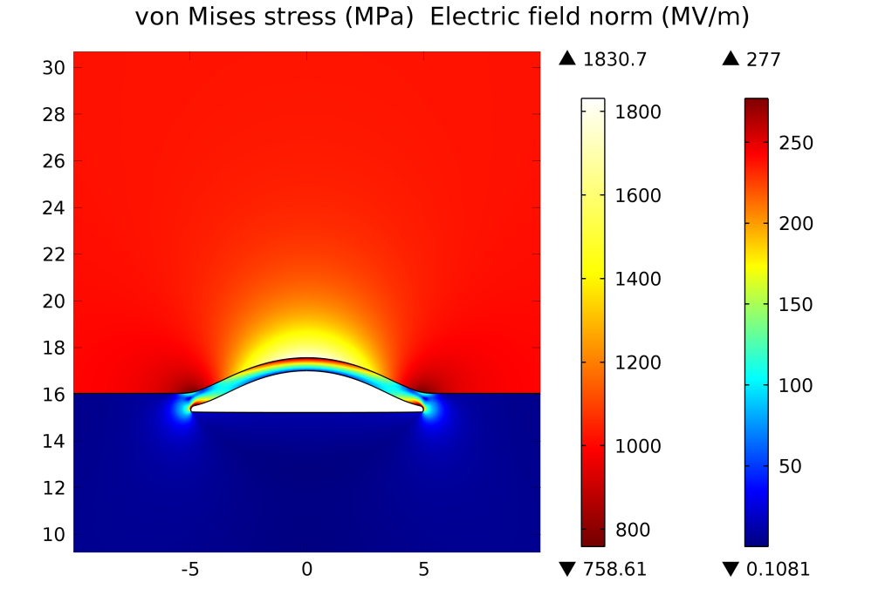
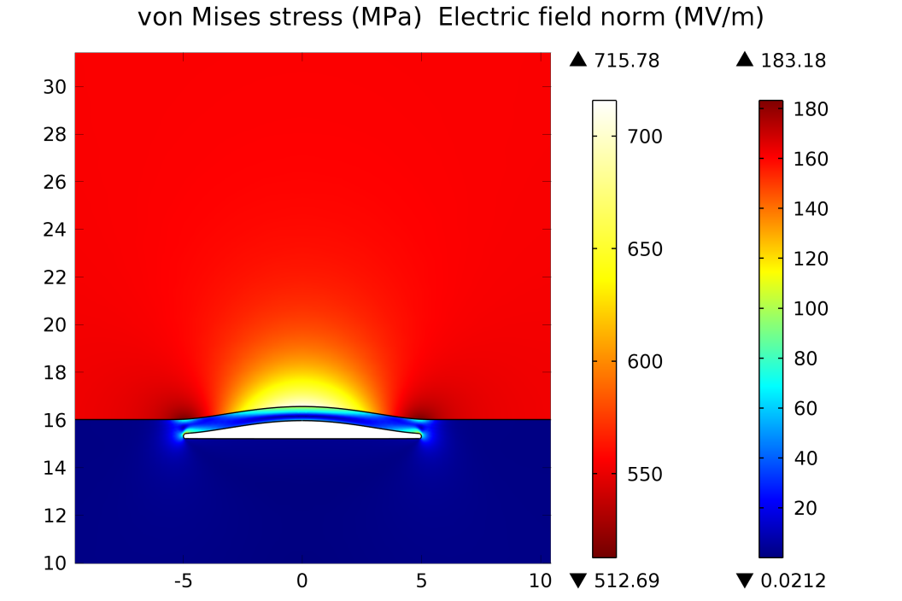
Effect of void shape
Void formation starts at fields > 400 MV/m
Material is plastic only in the vicinity of the defect
Thin slit may be formed by combination of voids or by a layer of fragile impurities
Field enhancement factor ~2.4
Thin material layer over the void acts like a lever, decreasing the pressure needed for protrusion formation

Slide 18
Yield point
Nonlinear dependence from the void depth
For h/r<0.3, yielding starts at void tip
For h/r=0.3, yielding equal at tip and sides
For h/r>0.3, stress is carried to the sides of the void
Three deformation mechanisms
Deformation at metal surface
Deformation at void surface
Deformation due to decreased surface area
Too deep void starts to decrease the effective surface area of the sample
Steel
Single crystal copper
Soft copper

Slide 19
Introduction: the characteristics of therapeutic beams
1. Better depth-dose distribution
2. Charged particles can be steered with magnets
3. Less energy is deposited into the healthy tissue
→ SPOT SCANNING
27 cm
Depth-dose
distribution
200 MeV - 1 nA
protons
4800 MeV – 0.1 nA
carbon ions
(radioresistant tumours)
Charged hadron beam that loses energy in matter
Tumour
target
Courtesy of PSI

Slide 20
Cyclinac = Cyclotron + Linac for hadrontherapy
 | Beam always present | Energy variation by electronics means | Time to vary energy
Cyclotron | YES | NO | 50 ms
Synchrotron | NO | YES | 1 s
Cyclinac | YES | YES | 2 ms
ACTIVE ENERGY MODULATION +
HIGH REP RATE PULSED BEAM
LinAc
to the patient
Best suited for treating moving organs with spot scanning technique combinend with 3D feed-back systems and multi-painting
External pulsed source
High current CYCLOTRON
Notes:
In particle physics, a hadron ^{i}/ˈhædrɒn/ (Greek: ἁδρός, hadrós, "stout, thick") is a composite particle made of quarks held together by the strong force (in the same way as atoms and molecules are held together by the electromagnetic force).
LinAcc-s are used to produce x-rays as well. Fast deacceleration of electrons.

Slide 21
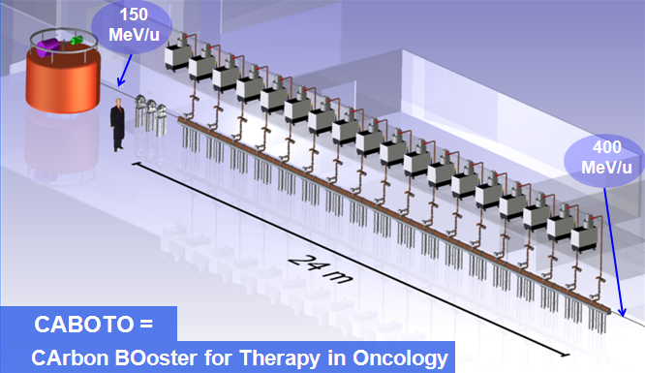
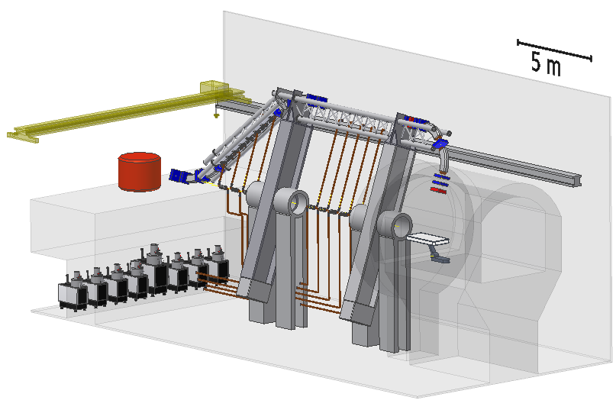
High gradients are needed to keep the machine compact
CABOTO:
Length < 25 m
E_{a} > 20 MV/m
TULIP:
Length < 10 m
E_{a} > 20 MV/m
TULIP=
TUrning LInac for Protontherapy

Slide 22
Summary
High gradients are needed to keep the machine compact
Electrical breakdowns must be under control
Material deformation due to voids
Protrusion shape is similar for all simulated materials
Material deformation starts after exceeding yield strength
Three protrusion generation mechanisms
Deformation mechanisms change at h/r~0.3 and h/r~ 1
Too deep void starts to decrease the effective surface area of the sample
New opportunities for radiotherapy (hadron therapy)

Slide 23
Thank you for your attention!

Slide 25
Some CLIC facts
Accelerator length 50 km
Distance between Tartu-Otepää ~41 km
Accelerating field 100-150MV/m
Electrical breakthrough in air at 3MV/m
Theoretical electirc breakdown in CLIC ~11-12 GV/m
High elelectric field is needed to minimize the length of the accelerator
High electric field leads to repeated electrical breakdown problem
Electron-positron beam collisions at the energies from 0.5 TeV to 5 TeV

Slide 26
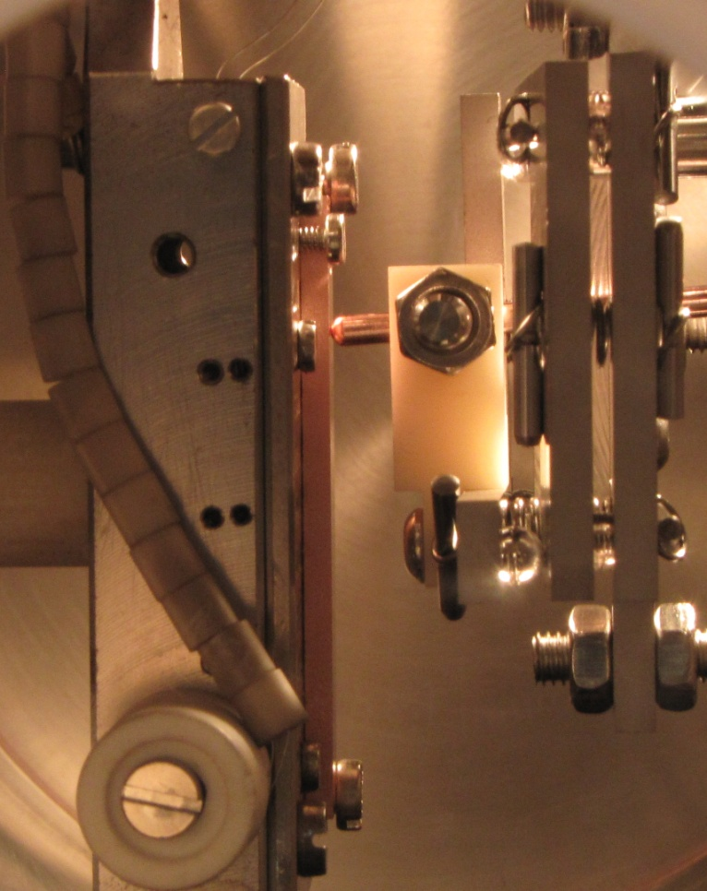
…Multiscale/multiphysics computational model to simulate electrical breakdown
Stage 1: Charge distribution @ surface
Method: DFT with external electric field
~few fs
Stage 2: Atomic motion & evaporation
+
Joule heating (electron dynamics)
Method: Hybrid ED&MD model (includes Laplace and heat equation solutions)
~few ns
~ sec/min
~ sec/hours
Stage 3a: Onset of tip growth; Dislocation mechanism
Method: MD, ED+MD, FEM…
Stage 3b: Evolution of surface morphology due to the given charge distribution
Method: Kinetic Monte Carlo
Stage 4: Plasma evolution, burning of arc
Method: Particle-in-Cell (PIC)
~10s ns
Stage 5: Surface damage due to the intense ion bombardment from plasma
Method: Arc MD
~100s ns
R. Behrisch, Plenum, 1986
B. Jüttner, 1979

Slide 27
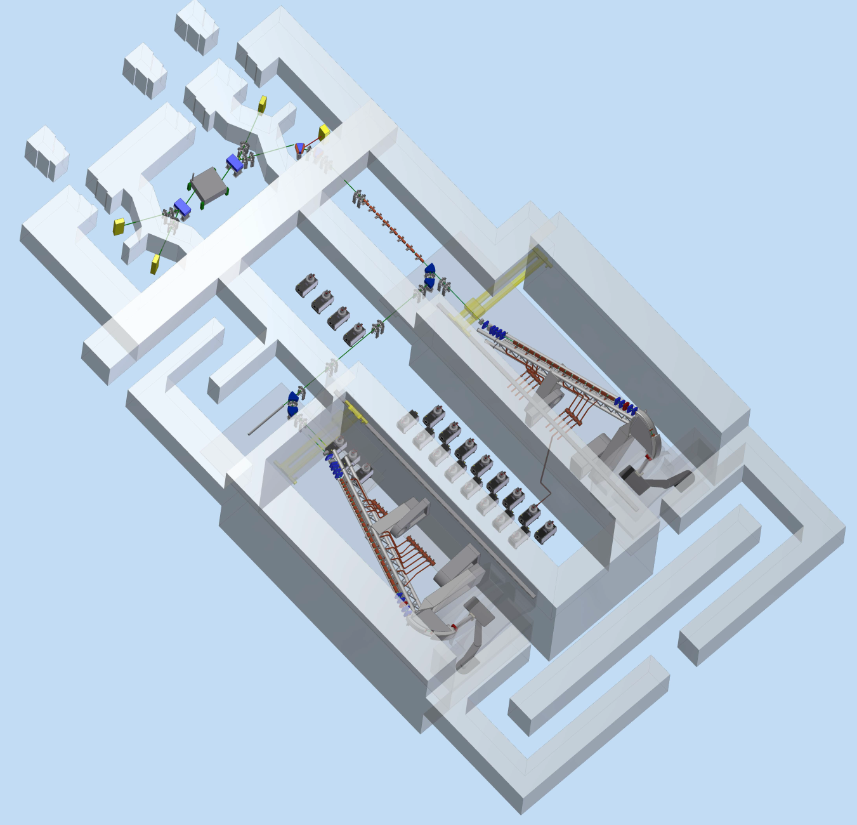
Proposal with two treatment rooms

Slide 28
Properties of the beam of different accelerators
 | Beam always present during treatment | Energy variation by electronics mean | Time needed to vary the energy
Cyclotron | YES | NO | 50 ms (*)
Synchrotron | NO | YES | 1 s
Cyclinac | YES (**) | YES | 2 ms
(*) with fast moving absorbers
(**) rep rate up to 300 Hz
Cyclinac is best suited for treating moving organs with spot scanning technique combinend with 3D feed-back systems and multi-painting

