Slide 1
Low voltage linear actuators based on carbide derived carbon powder
Janno Torop
Mati Arulepp, Jaan Leis
Urmas Johanson, Andres Punning
Alvo Aabloo
IMS Lab
University of Tartu
Estonia

Slide 2
Outline
Actuator description
Materials used
  Preparation and properties of CDC etc...
  Assembling the actuator
Electromechanical charaterization
Electrochemical characterization
Force-amplitude performance
Stability

Slide 3
Purpose of research
Microactuators
  Pump-valve systems for microfluidics
  Fine tuning of optical surfaces

Slide 4
Actuator
Notes:
Separator – porous cellulose separator---Nippon Kodoshi

Slide 5
Materials: Carbide-Derived Carbon

Slide 6
Fabrication of CDC
Metal carbide lattice is used as a template
Metal is extracted layer-by-layer
Exotermic reaction
Atomic level control controlled by synthesis parameters, like temperature, gas flow, reaction time

Slide 7
Unique features of CDC
Varied pore size by process parameters
Controlled nanostructure and crystallinity
Controlled dominating pore size at nano-level
Tuned pore size distribution
Optimized structure and porosity depending on the application

Slide 8
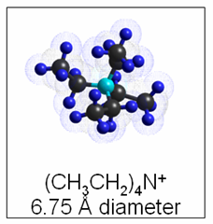
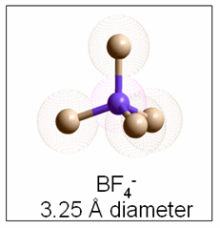
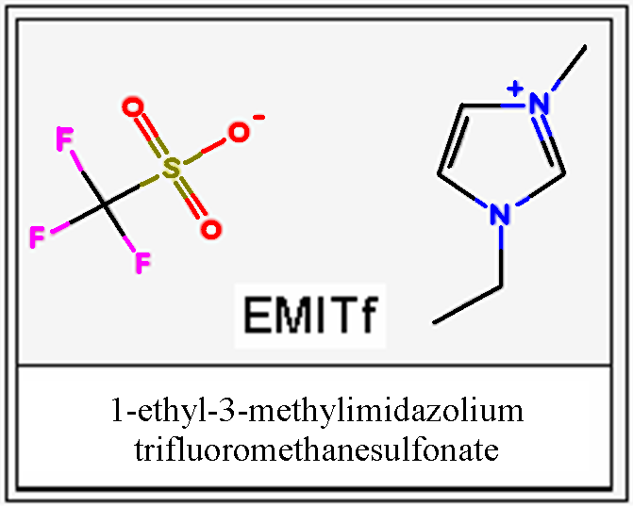
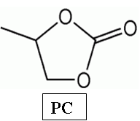
CDC and electrolyte properties
Notes:
T_{Chlorin}- Temperature of chlorination (powder synthesis)
S_{A}- Specific area
V_{p}- Volume of porosity per gram
V_{m}- Volume of micropores per gram
APS- Average pore size (Measured from N₂ adsorption)
Karbiidset päritolu süsinikmaterjalidena olid kasutusel TiC (titaan karbiidist) 600 °C ja 800 °C juures kloreerimisel saadud süsinik pulbrid. 600 °C juures valmistatud pulber on oluliselt mikropoorsem: 70 % pooridest on väiksema diameetriga kui 11 Å ja keskmine poori läbimõõt on 9,3 Å.
The electrolytes used in this study were 1.0 M tetraethylammonium tetrafluoroborate in propylene carbonate and the ionic liquid 1-ethyl-3methyl-imidazolium trifluoromethane-sulfonate EMITf.

Slide 9
Assembling
Notes:
Evaporation at 120 C, lihtsalt kuivatamine vedelikud, vesi, adsobeerunud gaasid, et poorid oleks puhtad
Rolling valtsimine...termin
Kile karpi
Imeb karbi tyhjaks
Eektrolyyt asemele ehk imetakse sisse
valmis mootmisteks

Slide 10
Electromechanical characterization: setup

Slide 11
CCCP measurement
CCCP – Constant Current Constant Potential
Notes:
Selleks et määrata maksimaalset nihet
In order to research the actuators in detail, the CCCP mode was used - after charging the actuator to certain voltage using constant current I_{C}, a constant potential V_{C} was applied for up to 5 minutes. This method helps to examine the dynamics and peak of the actuation of the actuators. During the period of the constant potential the current decreases substantially and the peak of actuation appears in few minutes. In the course of different experiments the amperage of the constant current was varied in the range of 50 to 1000 mA.

Slide 12
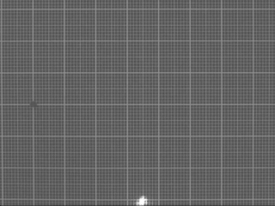
E-M Measurements
Notes:
Figure depicts the series of periodic charging-discharging cycles of the actuator. As the charging current is high, the period of constant current ceases already in few seconds. During time interval of 5 sec almost no actuation is detected, since the voltage is low and the adsorption of ions is a diffusion-limited process in the porous electrodes. The current dies away slowly due to the internal resistance of the actuator. While discharging by a short-circuit, the adsorbed energy is wasted through the resistor.
The actuation throughout the simultaneous cycles is of similar characteristics. The peak of actuation – 12 μm – is gained in the both cycles. The average speed of actuation can be calculated from the data of actuation and is 0.2 μm/s. Due to the low speed of desorption of ions of the ionic liquid from the porous carbon, the process of discharging is slow and the cell does not relax to its initial thickness between the simultaneous cycles.

Slide 13
Charge-Displacement Diagram

Slide 14
Electrochemical impedance spectroscopy (EIS)
Notes:
Nyquist plot z’/z’’ kompleks takistus, z’ reaalosa, z’’ on imaginaar osa, nullpunktiga loikamine on moodetav Z
Rakk alalsi komponendi alla, ning moduleeritakse vahelduv vooluga, ning muduetakse sagedust...
Suurtel sagedustel mahtuvus kukub... Aeglased mõõtmised.....käitub kui klassikaline kondekas

Slide 15
Cyclic Voltammetry
Notes:
Erinevad sysinikud, sama elektrolyyt
600, on oluliselt mikropoorsem kui 800, 2mV/sekundis laadimine, siis mahtuvused on võrreldavad, kui laadimiskiirust muuta, siis 600 jaab kehvamaks ja aktuaatorina aeglasemaks
Takistatud on elektrilise kaksikkihi laadimise kiirus ja ulatus.
Mikropoorsem st poorid on väiksemad ja neid rohkem

Slide 16
Energy loss
Notes:
Palju kaduma laheb charge ja discharge tsykli jooksul

Slide 17
Lifetime
Electric double layer capacitor
Expected lifetime at least 10⁶ cycles
Specific porous

Slide 18
Results
The electrochemical parameters series capacitance (C_{s}), series resistance (R_{s}), round-trip efficiecy (RTE) and actuation of linear actuators.
Notation of actuator | C_{s} [F g⁻¹] | R_{s} [Ω∙cm²] | Actuation at 3 V [μm] | RTE %
TEA600 | 64 | 3.9 | 10.2 | 84
TEA800 | 112 | 9.3 | 11.7 | 68
EMI600 | 75 | 7.3 | 16.2 | 72
EMI800 | 121 | 4.6 | 13.5 | 84
Notes:
RTE cycle efektiivsus protsentides

Slide 19
Conclusions
Supercapacitor like linear actuator was prepared
Several CDC- electrolyte systems prepared
Actuation aplitude, speed and effectiveness creatly depends from porous material properties-electrolyte pair choice,
  max 81 %, capacitance 121 g/F, actution 13.5 mikrom (5.8%),
Good lifetime
Energy recycling ☺ possibility

Slide 20
Acknowledgements
U.S. Civilian Research & Development Foundation
Estonian Science Foundation

Slide 21
Thank you!

