Slide 1



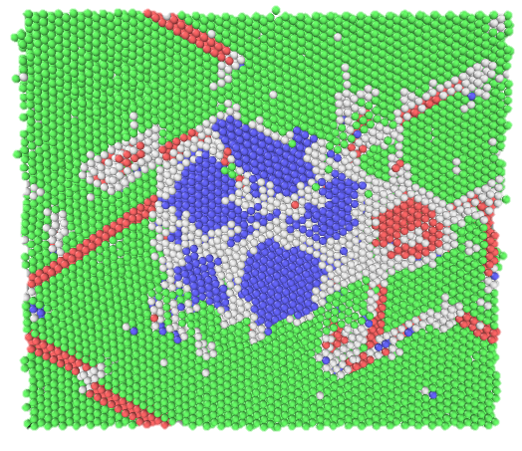
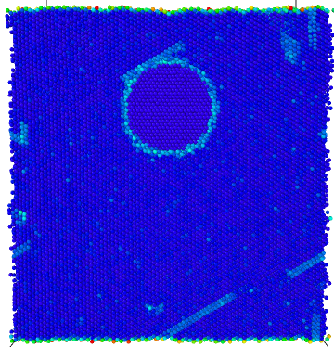
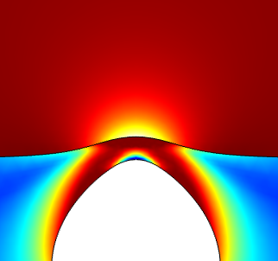
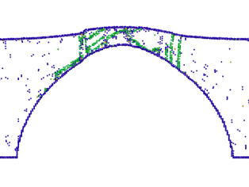
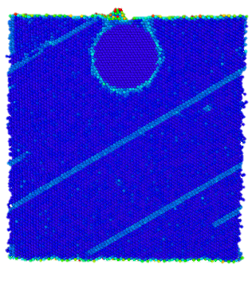
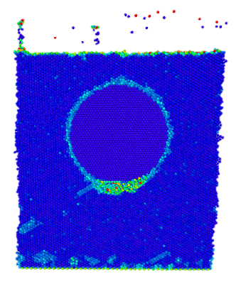
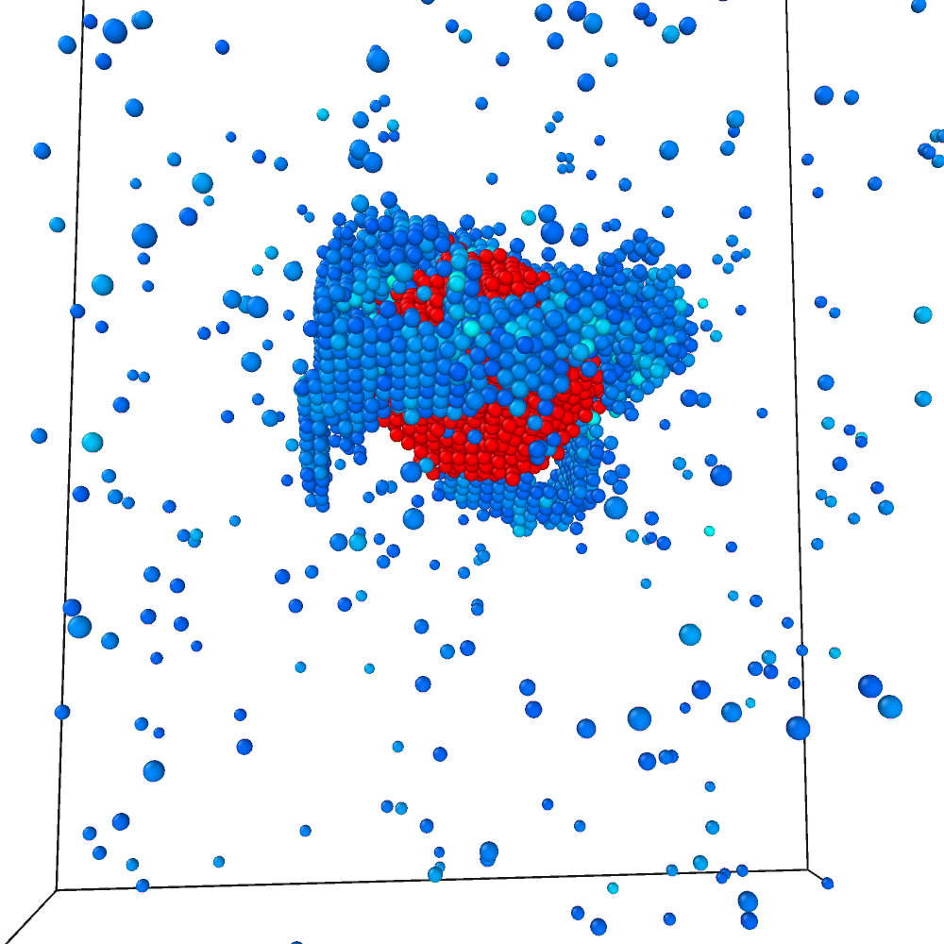
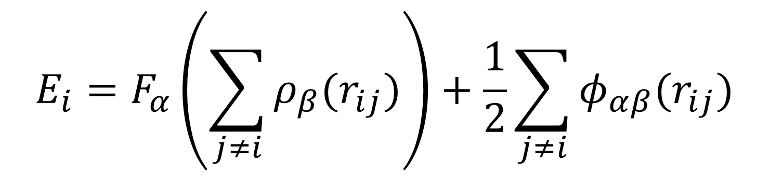
MD Simulations of Fe Precipitates in Cu
Simon Vigonski¹, Vahur Zadin¹, Alvo Aabloo¹, Flyura Djurabekova²
¹Institute of Technology, University of Tartu
²Univeristy of Helsinki
Correspond to: simon.vigonski@ut.ee
Motivation
Setup
Methods
Frequent vacuum break-downs in CLIC accelerating structures are presumably caused by field-enhancing empitters appearing on the surface. The origin of these emitters is hypothesized to be caused by plastic deformations and dislocations. We investigate the effect of voids and precipitates on dislocation nucleation.
Force
h
Classical molecular dynamics with LAMMPS, using the Bonny et al. many-body EAM potential. [1]
r
Fe
Fixed boundary
z
x
Cu
Box dimensions: 186x193x199 Å
Cu <110> direction in z
Various r and h
$$E_{i}=F_{α}\left(\sum_{j≠i}{ρ_{β}(r_{ij})}\right)+\frac{1}{2}\sum_{j≠i}{φ_{αβ}(r_{ij})}$$
Near-surface voids
Fe precipitates in Cu
Voids near the surface act as stress concentrators in a high external electric field. They are nucleation centers for dislocations that lead to stable protrusions on the surface. [2]
Unlike voids, Fe precipitates show little ability to nucleate dislocations. No surface geometry change is visible even under very high electric fields.
E = 22.8 GV/m, t = 180 ps
A Fe precipitate protruding on the surface results in quick and extensive evaporation on the Fe-Cu-vacuum interface.
E = 22.8 GV/m, t = 10 ps
Continually increasing the electric field was found to create a void below the precipitate just before extensive surface vaporization.
Irregular precipitates
Inserting Fe as an fcc structure relaxes it into an irregular bcc sphere and creates a knot of Cu dislocations around it.
E = 29.1 GV/m
Conclusions
Red – Fe
Blue – Cu dislocations
Fe precipitates provide less dislocation nucleation than voids
Precipitates adjacent to the surface facilitate vaporization
Irregular precipitates offer more dislocation nucleation sites
[1] Bonny, G., Pasianot, R. C., Castin, N., Malerba, L., Philos. Mag. 89, 3531–3546 (2009).
[2] Pohjonen, A. S., Parviainen, S., Muranaka, T., Djurabekova, F., J. Appl. Phys. 114, 033519 (2013).
Tänusõnad – PUT57, CERN+ ….

