Slide 1


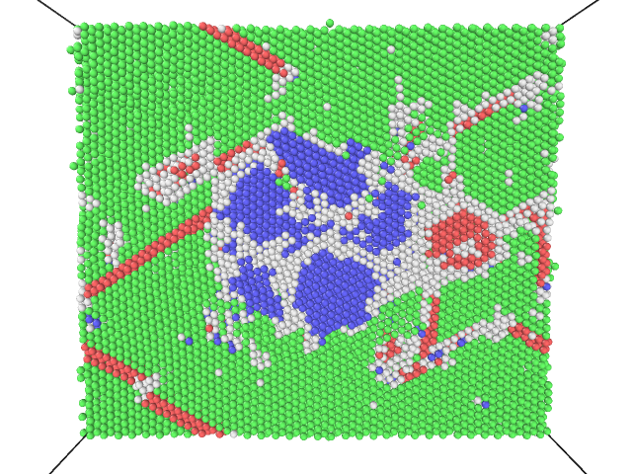
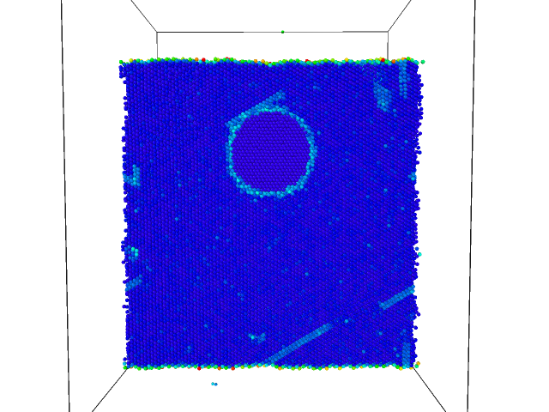
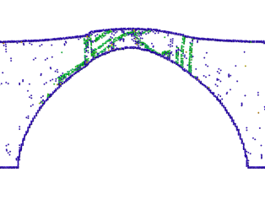
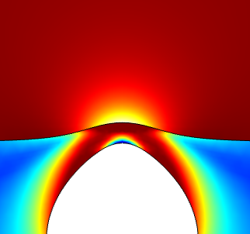
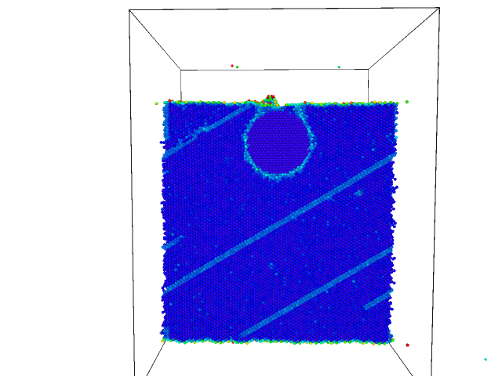
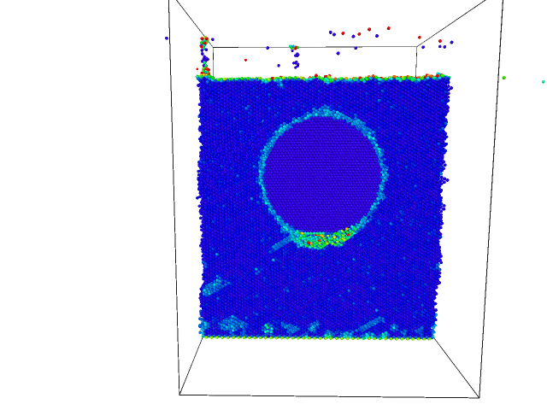

MD simulations of Fe precipitates in Cu
Simon Vigonski et. al
Kontaktandmed
Motivation
Setup
Methods
Frequent vacuum break-downs in CLIC accelerating structures are presumably caused by field-enhancing needles appearing on the surface. The origin of these needles is unclear and voids or precipitates near the surface could be the cause.
h
Classical molecular dynamics with LAMMPS.
Using the Bonny et al. many-body EAM potential. [1]
r
z
x
$$E_{i}=F_{α}\left(\sum_{j≠i}{ρ_{β}(r_{ij})}\right)+\frac{1}{2}\sum_{j≠i}{φ_{αβ}(r_{ij})}$$
Box dimensions: 186x193x199 Å
Cu <110> direction in z
Various r and h
Near-surface voids
Fe precipitates in Cu
Voids near the surface act as stress concentrators in a high external electric field. They are nucleation centers for dislocations that lead to stable protrusions on the surface. [2]
E = 22.8 GV/m, t = 180 ps
E = 22.8 GV/m, t = 10 ps
Continually increasing the electric field was found to create a void below the precipitate just before extensive surface vaporization.
E = 29.1 GV/m
Grain boundary simulations – võib olla, kui midagi mõistliku on
Järeldused
[1] Bonny, G., Pasianot, R. C., Castin, N. & Malerba, L., Philos. Mag. 89, 3531–3546 (2009)
[2] Pohjonen, A. S., Djurabekova, F., Nordlund, K., Kuronen, A. & Fitzgerald, S. P., J. Appl. Phys. 110, 023509 (2011).
Tänusõnad – PUT57, CERN+ ….

