Slide 1
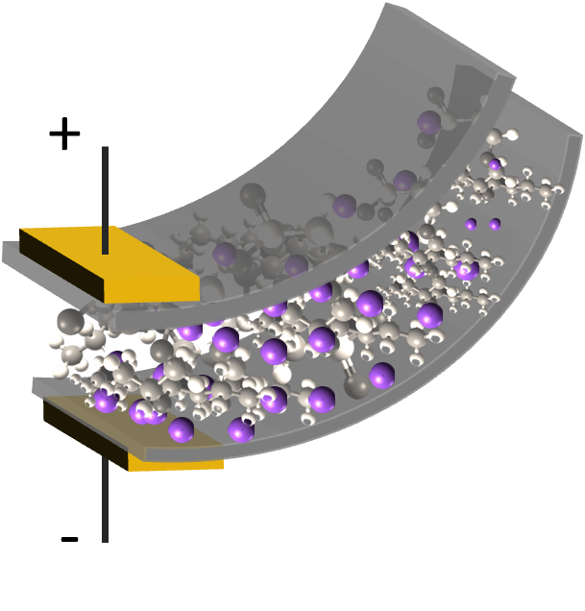
Smart Materials, Adaptive Structures & Intelligent Systems
September 21 – 23, Oxnard, California
Modeling IPMC material with dynamic surface characteristics
David Pugal*#, Alvo Aabloo#,
Kwang J. Kim*, Youngsoo Jung*
*Active Materials and Processing Laboratory (AMPL)
Low Carbon Green Technology Laboratory (LCGTL)
Dept. of Mechanical Engineering
University of Nevada, Reno
#IMS Lab, Institute of Technology, Tartu University, Estonia

Slide 2
Outline
IPMC material
Basic mathematical description of the actuation
Surface electrode model
Motivation
Physics background
Comsol Multiphysics simulations
Results
Conclusions
Notes:
Outline
First we tallk – everybody who knows it fairly well, please bear with me ☺
After that, surface electrode model, the motivation

Slide 3
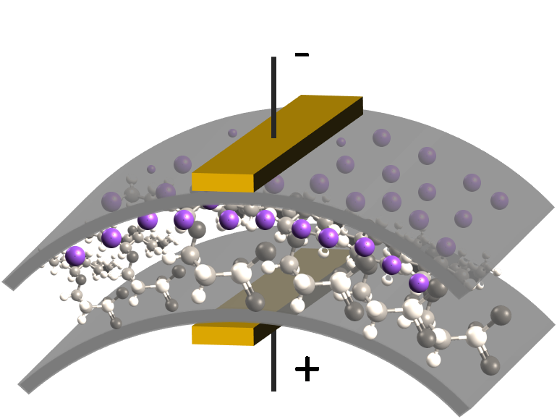
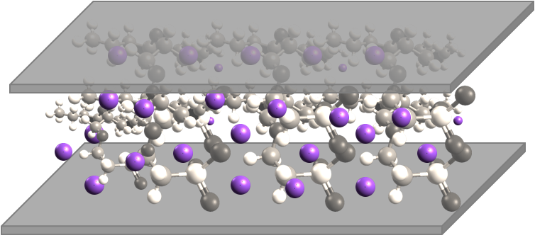
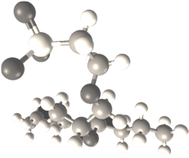
IPMC material
IPMC – Ionic Polymer-Metal Composite
Electromechanical behavior
Mechanoelectrical behavior
Nafion™ polymer
Hydrated cation

Slide 4
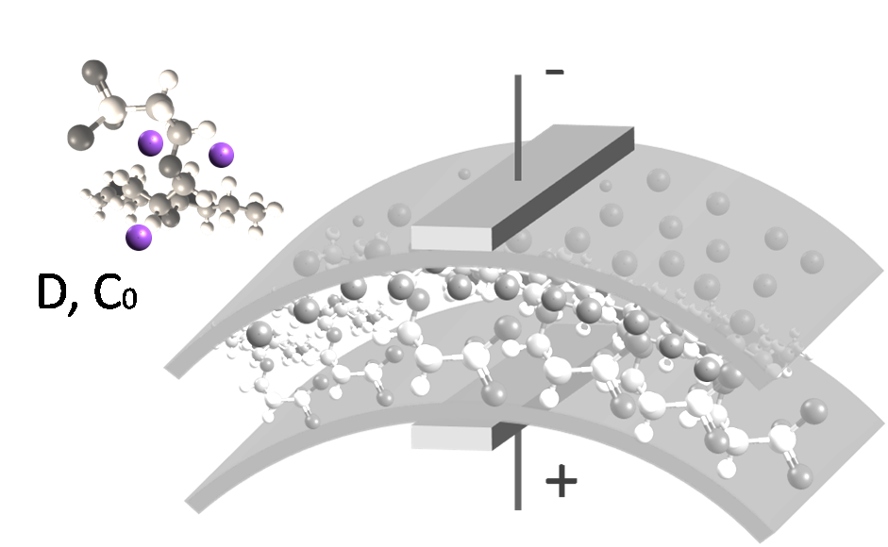
Simple model
The simple physical model:
Ion migration and diffusion, Nernst-Planck equation
C – cation concentration
D – Diffusion coefficient
z – charge number
– mobility
F – Faraday constant
– electric potential

Slide 5
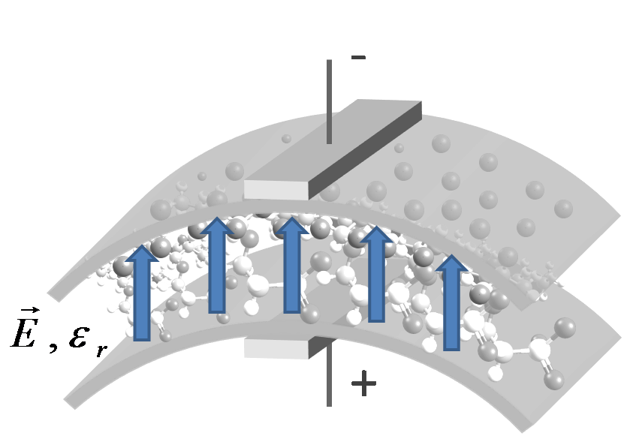
Simple model
The simple physical model:
Ion migration and diffusion
Electric field, Poisson’ equation
Describes the electric field in the IPMC
E – electric field
– potential
– charge density
– electric permittivity
F – Faraday constant

Slide 6
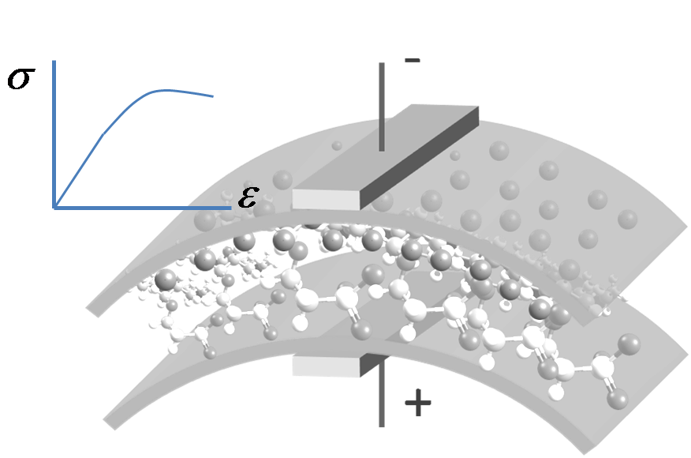
Simple model
The simple physical model:
Ion migration and diffusion
Electric field, Poisson’ equation
Stress-strain
Stress is related to the charge density
Not considered in this work

Slide 7
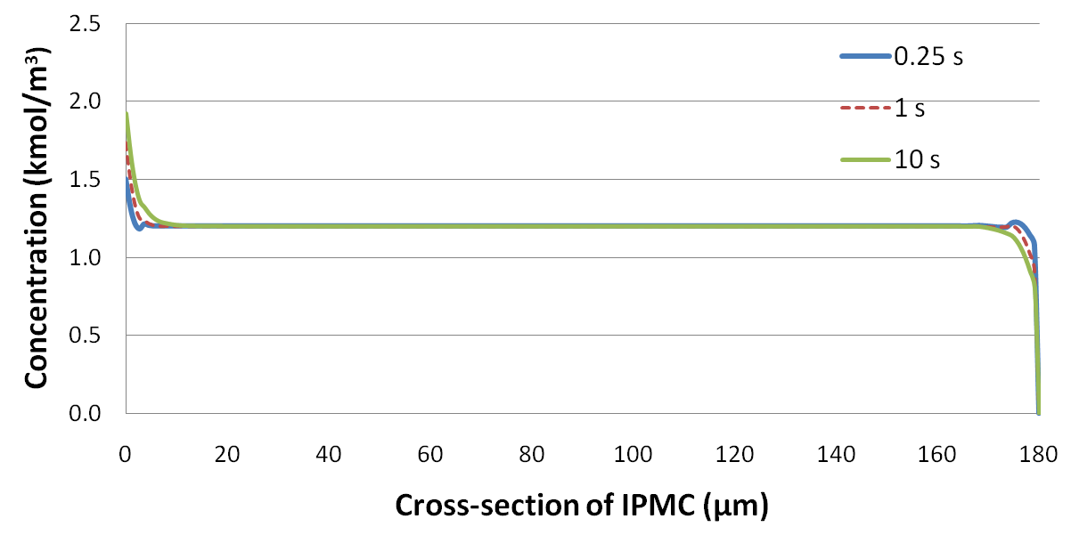
Concentration - Bending
Concentration graph
Bending related to concentration → electric properties

Slide 8
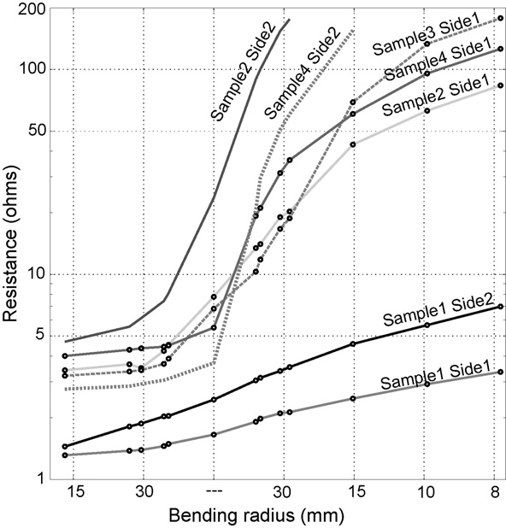
Electrode modeling - Motivation
Modeling effect of the electrodes on the potential inside the polymer. Why?
1)Some samples have shown significant dynamic surface resistance…
A. Punning, M. Kruusmaa and A. Aabloo, Sensors and Actuators, A: Physical 133 (1), 200 (2007).

Slide 9
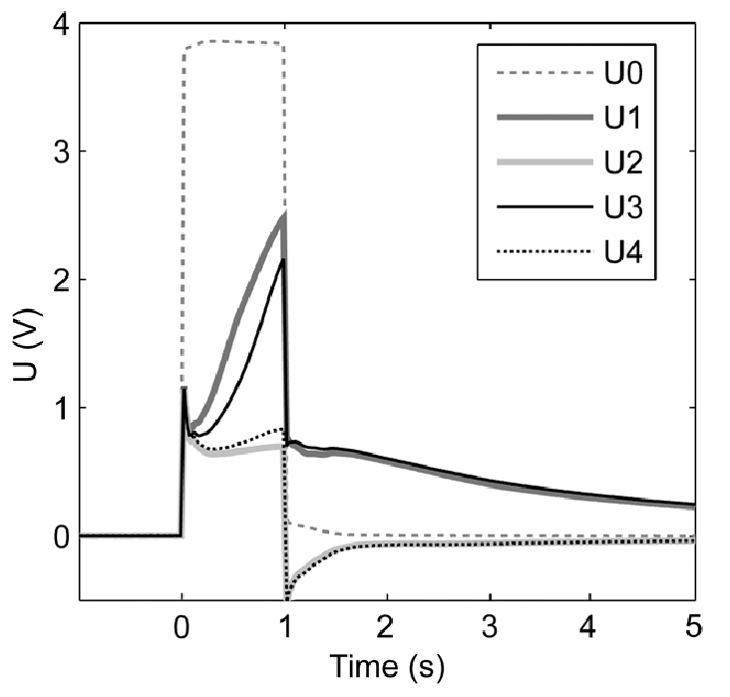
Electrode modeling - Motivation
… which leads to a voltage drop along the electrode
U0, U1, U3 measured on the one side of IPMC
Some of the drop is due to electrolysis
Part of it is due to surface resistance
U0, U1,U3
A. Punning, Dissertation Thesis, Tartu University, 2007.

Slide 10
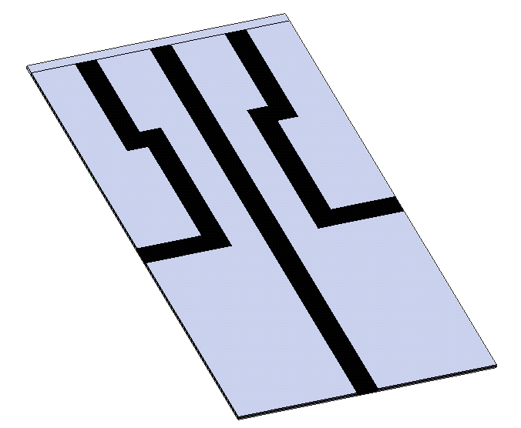
Electrode modeling - motivation
2) Patterned electrodes
3D bending
Different areas with different surface characteristics
3) Electrode conductivity characterization

Slide 11

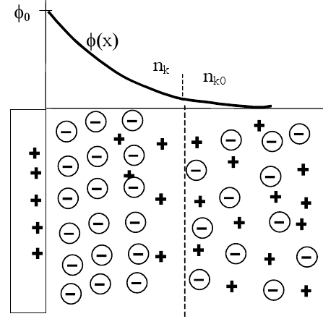
Surface resistance model - background
Tie together the current flowing through the surface and the ionic current inside the polymer
Ramo-Shockley theorem
Plasma phycis *
Ion channels in proteins #
Courtesy of M. Dingemans
* P. Paris, M. Aints, M. Laan, and T. Plank, “Laser-induced current in air gap
at atmospheric pressure,” Journal of Physics D: Applied Physics 38(21),
pp. 3900–3906, 2005.
# W. Nonner, A. Peyser, D. Gillespie, and B. Eisenberg, “Relating Microscopic
Charge Movement to Macroscopic Currents: The Ramo-Shockley Theorem
Applied to Ion Channels,” Biophysical Journal 87(6), pp. 3716–3722, 2004.
Courtesy of M. Laan

Slide 12
Surface resistance model – math.
Current in the external circuit:
By integrating over arbitrary trajectories, the charge:
The following relation for current density can be derived:
Final form that is used in the simulations

Slide 13
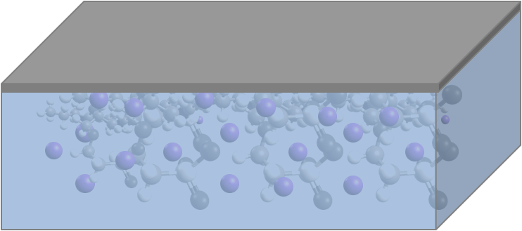
Surface resistance model - Comsol
Implementation in Comsol
2 different domains are modeled
1: Polymer (Nernst-Planck and Poisson’ equation)
2: Electrode (Ohm’ law)
B.C. Boundary between the bulk Nafion and electrode:
Integrated ion flux from domain 1 was projected as an input on domain 2:
Input voltage
2
1

Slide 14
Surface resistance model - Comsol
The electric current inside the IPMC is calculated by integrating the ion flux
The ion flux is “projected to the electrode” where it becomes a boundary condition for the electrode model
The voltage of the electrode model, in turn, becomes a boundary condition to the Poisson equation, which is responsible for the ion flux
Ion flux
current
electrode b.c
voltage drop

Slide 15
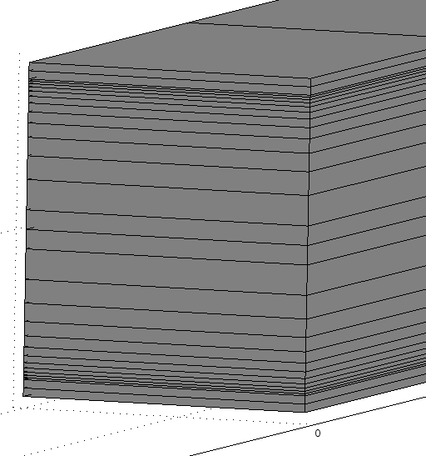
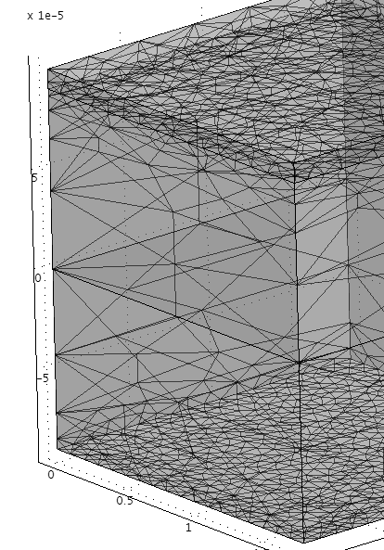
Surface resistance model - Comsol
Implementing in Comsol – meshing
Free mesh – due to projection coupling (both for 2D and 3D simulations)
Regular mapped mesh - faster

Slide 16

Results
2D modeling – experimental setup
2D modeling – the model
Small area of higher
Surface resistance
-
+
+
-
+
-
Probe 2
P2
Probe 2
Probe 3
Probe 3
p3
Straight IPMC
Bent IPMC

Slide 17
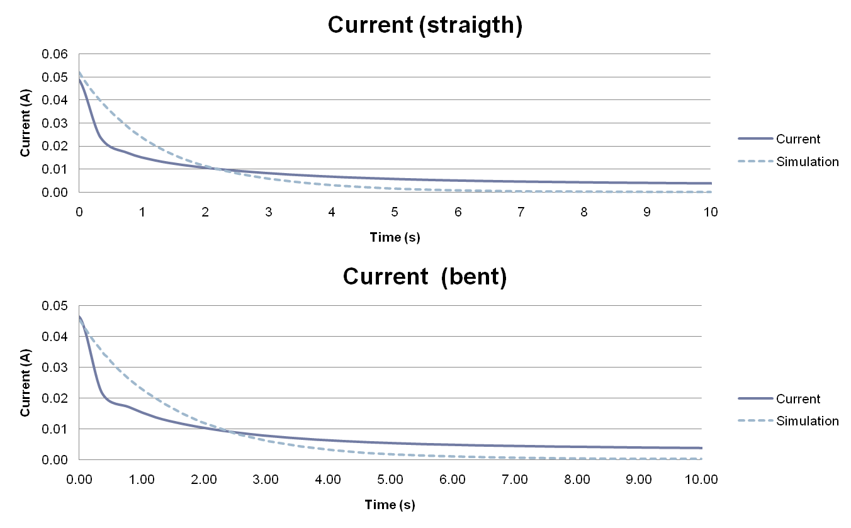
Results – 2D model, current
-
+
+
-

Slide 18
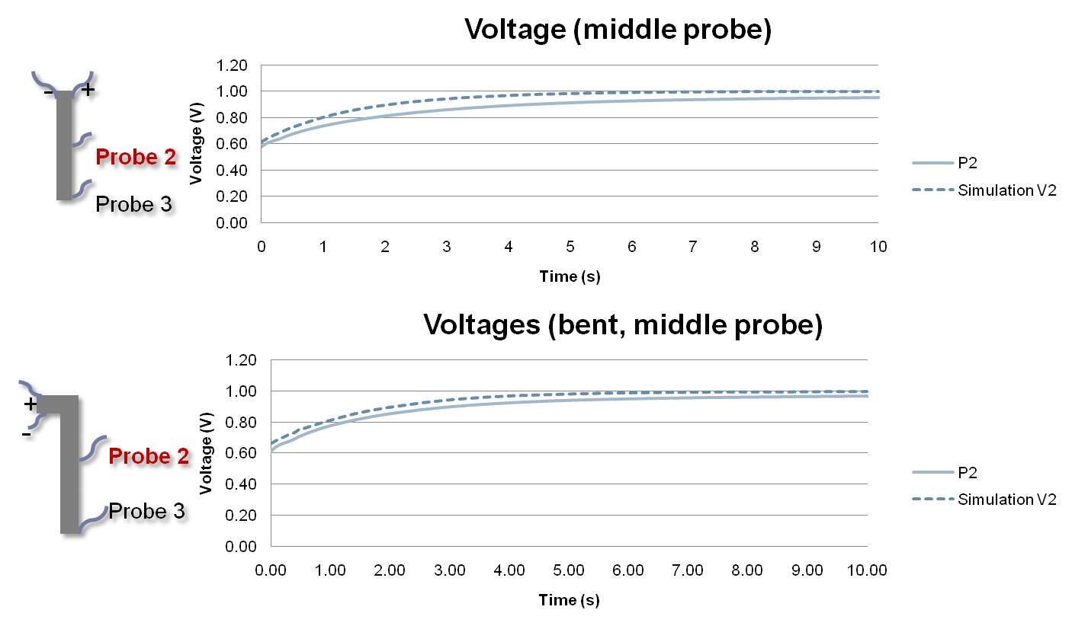
Results – 2D model, Voltage

Slide 19
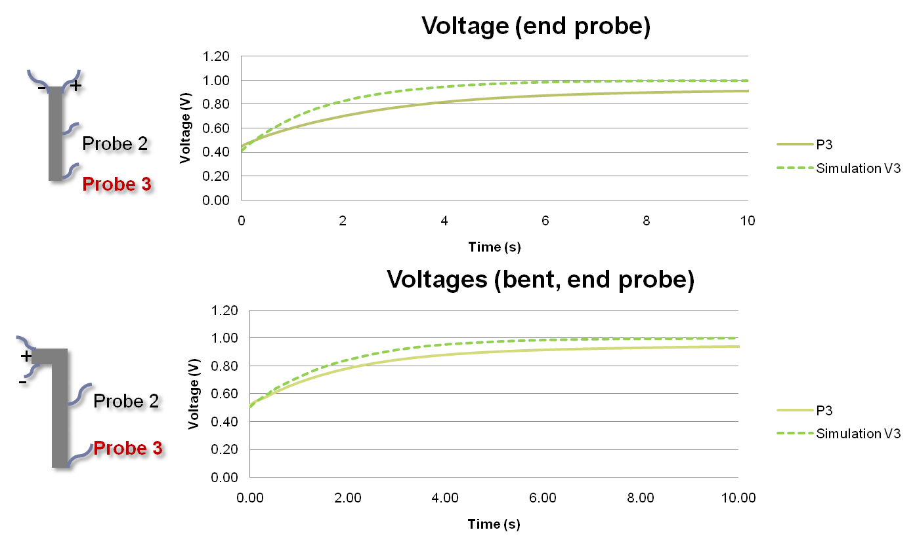
Results – 2D model, Voltage

Slide 20
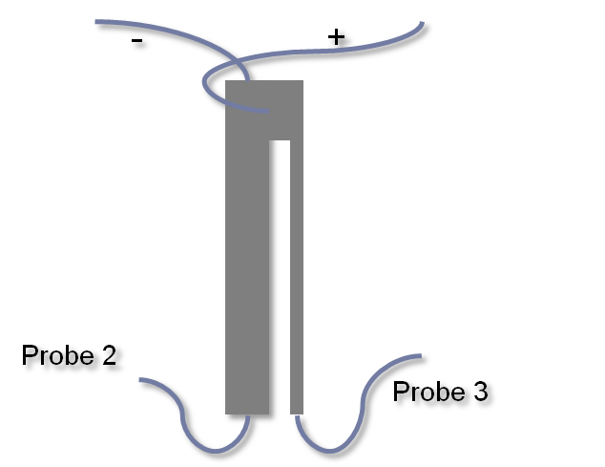
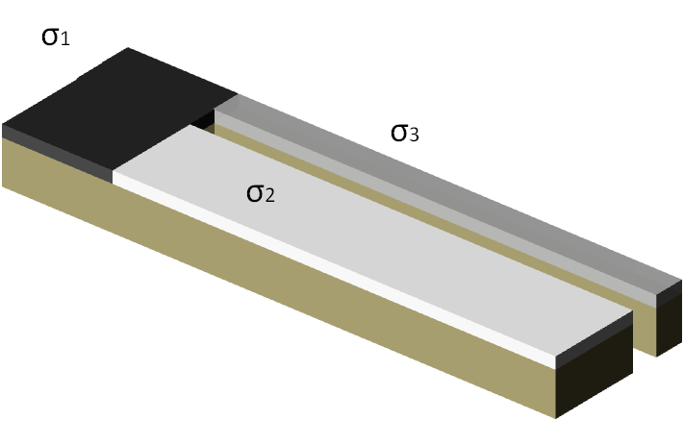
Results
3D modeling – experimental setup
3D modeling – the model
Scaled model is used!
Top view

Slide 21
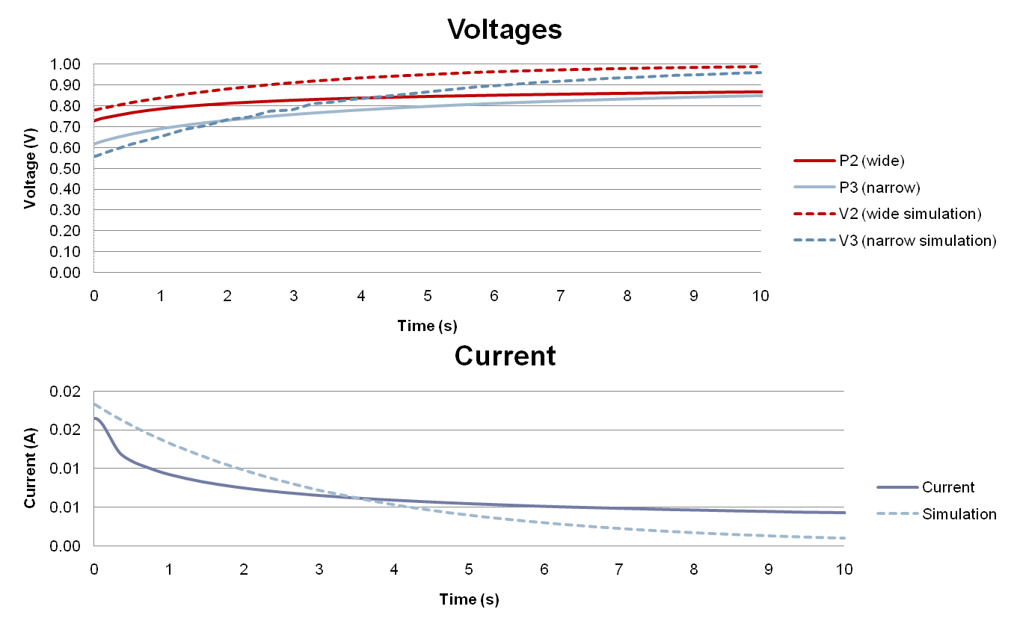
Results – 3D model

Slide 22
Discussion
The results show that the model predictions are correct
Both electric current and the voltage drop calculations are rather realistic
3D model works as well!
Some downsides of the model
Time consuming calculation
The convergence problems due to the feedback nature of the model
Possible solutions
Different solver?
Use time stepping instead of full time dependent solution
Simplify the model…

Slide 23
Results – simplifications
Loose the feedback
Better convergence
Reduced calculation time
Ionic current does cause the voltage drop on the electrodes
The voltage drop does not change the ionic current
Could be used for characterizing the surface – does not change the ionic behavior
Ion flux
current
electrode b.c
voltage drop

Slide 24
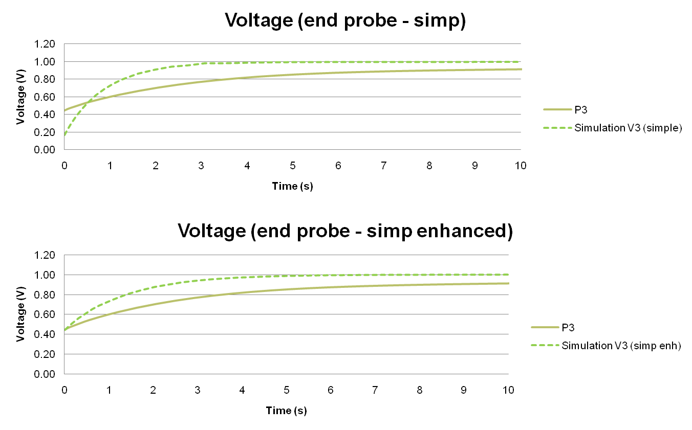
Results – simplified model
Changed diffusion constant.
Electric current value is not correct

Slide 25
Conclusions
The surface resistance model works fairly well
The 3D scaled model was developed
With simple 3D IPMC, the surface could be omitted and the full scale model can be used
Using Ramo-Shockley theorem is beneficial, when the surface resistivity plays important role
Surface treated IPMCs
More complicated structures
Future
Simplify the model, reduce solution time

Slide 26
Thank you
Questions?

