Slide 1
Dynamic Surface Resistance Model of IPMC
David Pugal^{a,b}, Alvo Aabloo^{b}, Kwang J. Kimª
ª Active Materials and Processing Lab, Mechanical Engineering dept. University of Nevada, Reno
^{b} IMS Lab, Tartu University, Estonia
3/11/2009

Slide 2
Outline
IPMC materials and the basic model
Extended Surface Resistance Model
Theoretical considerations
Possible applications
Simulations using Finite Element Method
Preliminary results
Concerns
Future Work

Slide 3
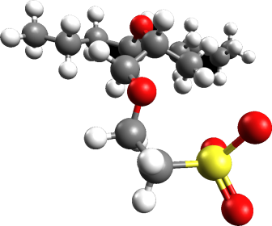

IPMC materials and the basic model
IPMC – ionic polymer-metal composite material
Electric field
Ion migration
Current/charge driven bending
Polymer
backbone
Free cation

Slide 4
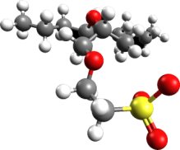
IPMC materials and the basic model
Charge migration and diffusion description
Nernst-Planck equation
Electric field – Gauss’ equation
Rather simple way to describe the field
In this research, the bending is not considered explicitly

Slide 5
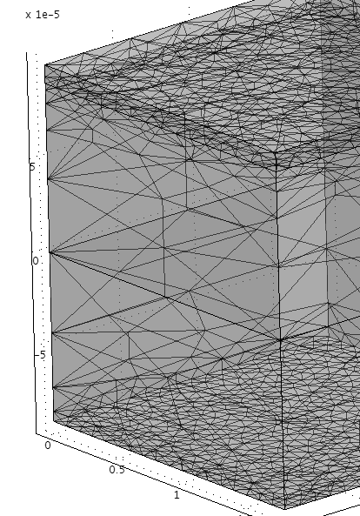

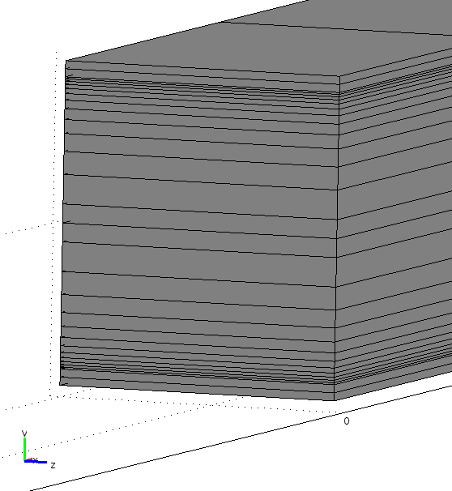
IPMC materials and the base model
Meshing for 2D and 3D
2D mapped mesh
3D mapped mesh

Slide 6
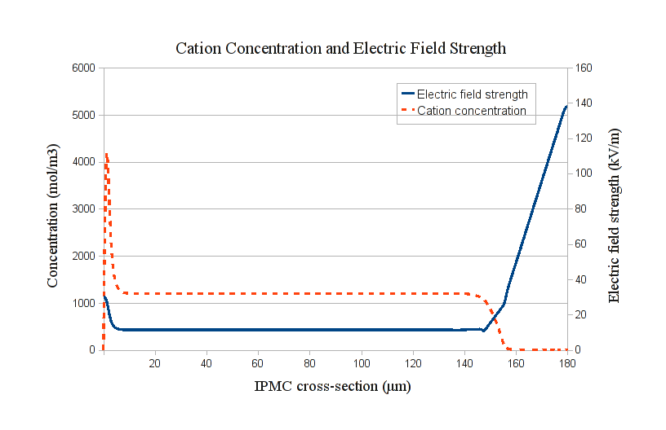
IPMC materials and the base model
The electric field and the cation distribution at t >> 0
Given model gives somewhat high field values for t >> 0
Otherwise the shape is physically reasonable

Slide 7
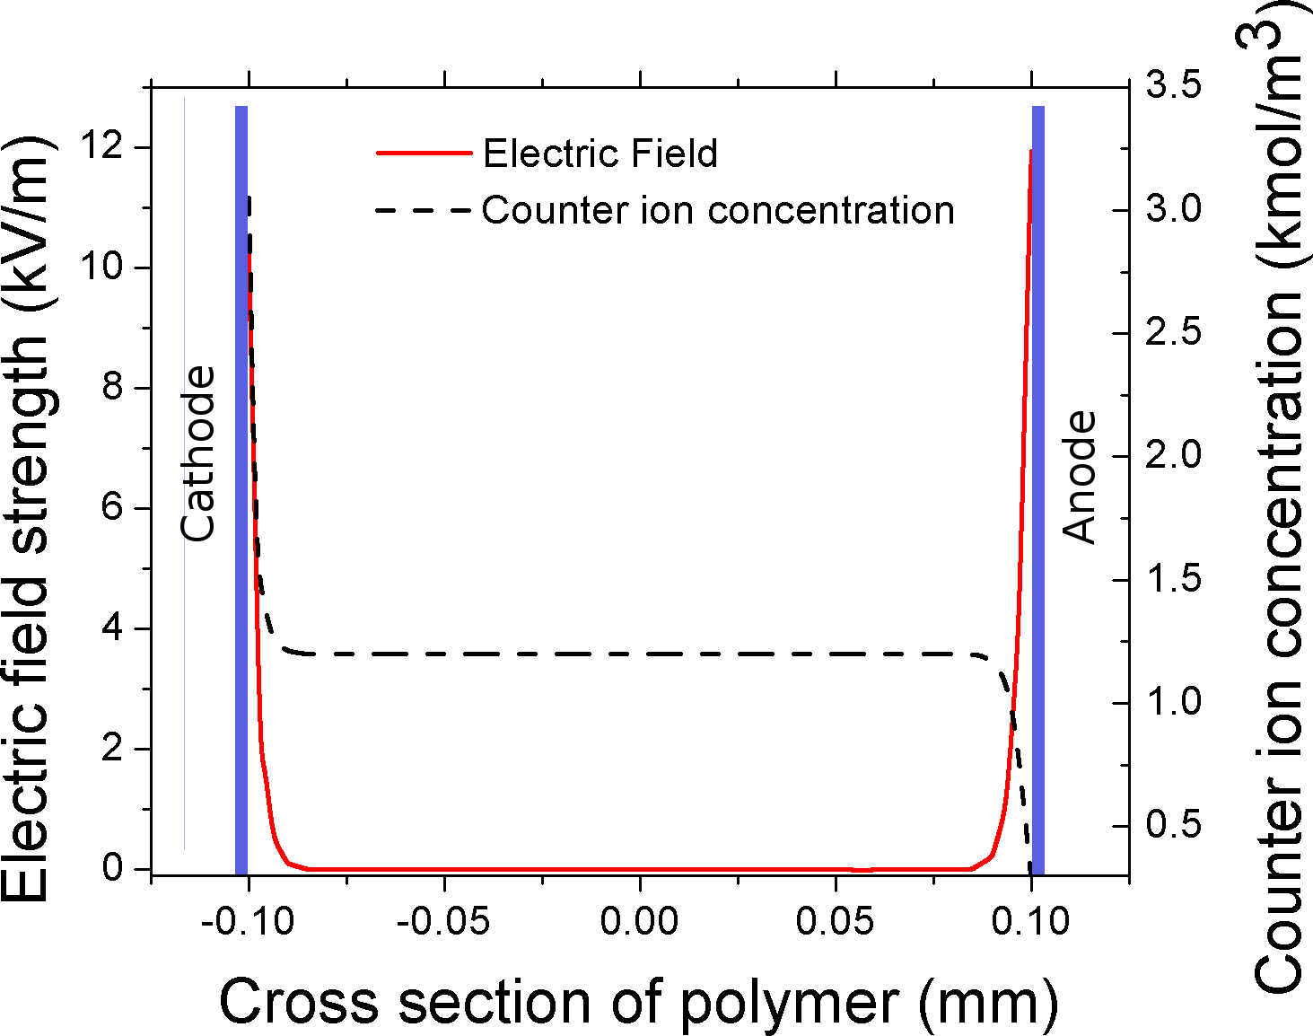
IPMC materials and the base model
The base model calculations depend on the chosen underlying equations
The Comsol Multiphysics is the modeling software
The previous graph was the result of choosing electrostatic model with specified voltage on boundaries.
The following graph is calculated using a general PDE formulation with specified field strengths*
* D. Pugal, K. J. Kim, A. Punning, H. Kasemagi, M. Kruusmaa, and A. Aabloo, “A self-oscillating ionic
polymer-metal composite bending actuator,” Journal of Applied Physics 103(8), p. 084908, 2008

Slide 8
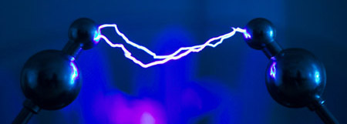
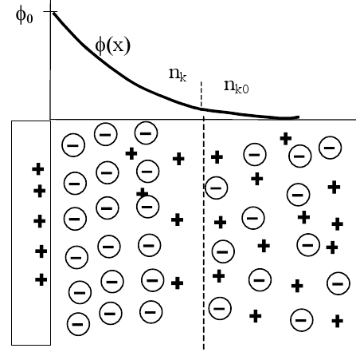
Extended Surface Resistance Model
The idea is to tie together current flowing through the surface and the ionic current inside the polymer.
The similar technique is used in
Plasma physics *
Ion channels in proteins #
Courtesy of Matthew Dingemans
* P. Paris, M. Aints, M. Laan, and T. Plank, “Laser-induced current in air gap
at atmospheric pressure,”
Journal of Physics D: Applied Physics 38(21), pp. 3900–3906, 2005.
# W. Nonner, A. Peyser, D. Gillespie, and B. Eisenberg, “Relating Microscopic
Charge Movement to Macroscopic Currents: The Ramo-Shockley Theorem
Applied to Ion Channels,” Biophysical Journal 87(6), pp. 3716–3722, 2004.
Courtesy of M. Laan

Slide 9
Extended Surface Resistance Model
Ramo-Shockley theorem
equates the total current (particle plus displacement) measured in the external circuit with the microscopic motion of the charged particles in the domain between the electrodes.
The current flowing into an electrode held at voltage V
By integrating over arbitrary trajectories, we can get the charge
For the capacitor model, the following relation can be derived:

Slide 10
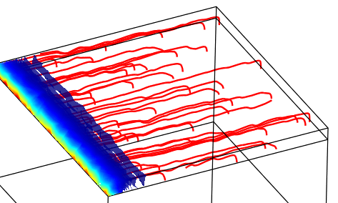
Extended Surface Resistance Model
Electrodes as continuous media
Electrodes could be considered as a set of finite resistors
Currents would add as Kirchoff law states
There exists a voltage drop along the resistors, therefore also along the whole electrode
The voltage drop would be as a feedback in some sense – the less voltage at the end of the electrode results in a different cation profile inside the polymer
R_{a}
R_{b}
R_{c}
R_{d}
R_{e}

Slide 11
Extended Surface Resistance Model
Possible applications
2D model
Allows to consider surface resistance changes and respective voltage drops in the electrodes
Different 2D electrode parameters could be considered
3D model
Allows modeling electrodes with more complicated surface characteristics – e.g. specific electrode shapes, laser altered surfaces, etc
Calculation of heat generation on the electrodes.

Slide 12
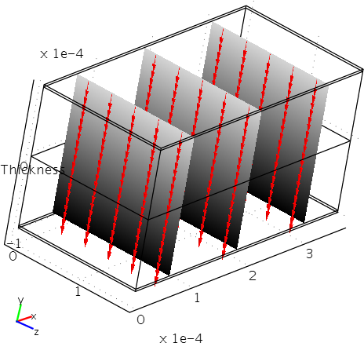
Extended Surface Resistance Model
Simulations using FEM
Proof-of-concept simulations made with a small section of IPMC
A base model without surface electrode. The arrows perpendicular to the surface denote the flux direction at the time t = 0.1

Slide 13
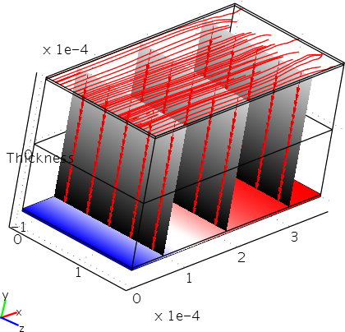
Extended Surface Resistance Model
Simulations using FEM
Added surface electrode.
The blue-red area indicates the voltage on the grounded electrode and the blue equals to 0.

Slide 14
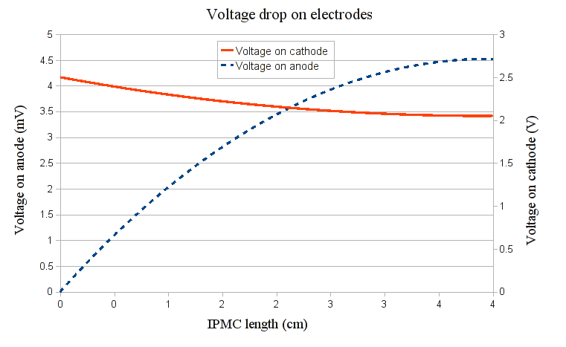
Extended Surface Resistance Model
Preliminary results

Slide 15
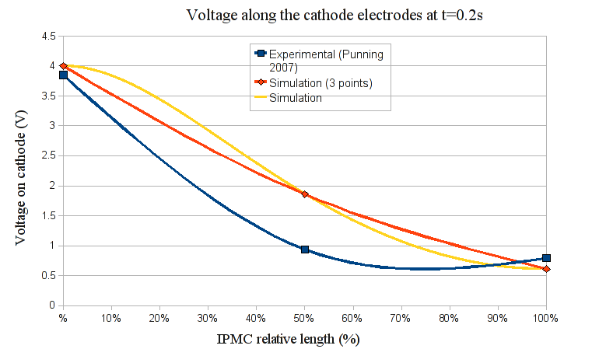
Extended Surface Resistance Model
Preliminary results

Slide 16
Extended Surface Resistance Model
Some concerns
For the variable resistance (3D), the calculation is too slow for the entire IPMC – must find ways to simplify
Possible solutions:
Do as many calculations as possible for small section of IPMC and extrapolate the results where possible
Generate more efficient mesh – different powerful open source tools are available such as gmsh, etc.
For instance, somewhat optimized mapped mesh for a 4cm x 1cm piece of IPMC results in ~100,000 DOF → large solution time ( > 30min)

Slide 17
Extended Surface Resistance Model
Some concerns
Direct usage of Ramo Shockley theorem is hard in time dependent simulations.
The integration of current density is needed over the polymer subdomain
That in turn requires free mesh (Comsol Multiphysics) → significantly increased calculation time.
The possible solutions may include:
Find different solver
Use time stepping to include the currents and voltage drops (instead of full time dependent simulation)
Further research coupling different domain
Convergence problem when using the integrated value
Weak-from solution

Slide 18
Conclusions and Future Work
We have developed a base model to model the simple physical processes such as ion migration and electric field change in an IPMC
Extended model has shown some promising results for calculating currents in the electrodes.
The model has been shown to work in 3D as well.
Still some concerns must be addressed to get a fully functional model
More testing is needed.

Slide 19
Thank You
Acknowledgements
The authors from University of Nevada, Reno (UNR) acknowledge the financial support from the U.S. National Science Foundation (Award#: 0713075).
We also acknowledge the financial support from
The European Science Foundation DoRa programme
RDF-ETF joint grant no. ESE1-2902-TR-07.

Slide 20

Questions
Thank You and Questions please ☺

