Slide 2
-
-
μ ~ rirc/(3Rc)
+
+
rc
+
+
-
-
rc – ri
+
+
-
-

Slide 3
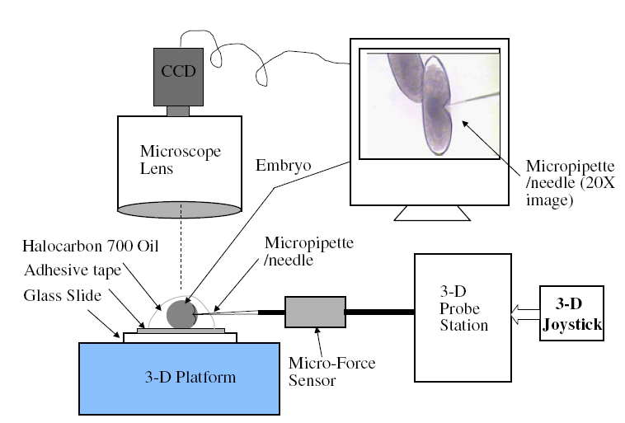

Slide 4
CCD
Screen
Microscope lens
Halocarbon 700 oil
Adhesive tape
Glass slide
Embryo
Micropipette
needle
3D probe station
3D Joystick
Micro force
sensor
3D platform

Slide 5
Pt
R
Nafion
R

Slide 6
αR
βR
α >> 1, β < 1

Slide 7
ν
i
f

Slide 8
N : 1
Z_{p}
Z_{m2}
i
ν
R_{dc}
Z_{mI}
f

Slide 9
f
ν
i

