Slide 1





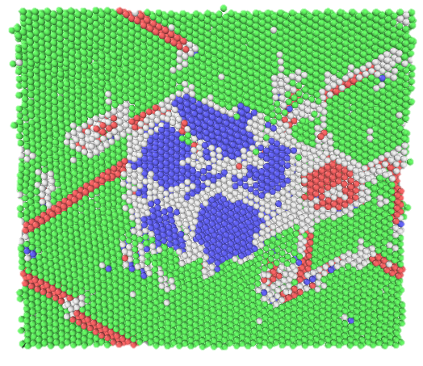
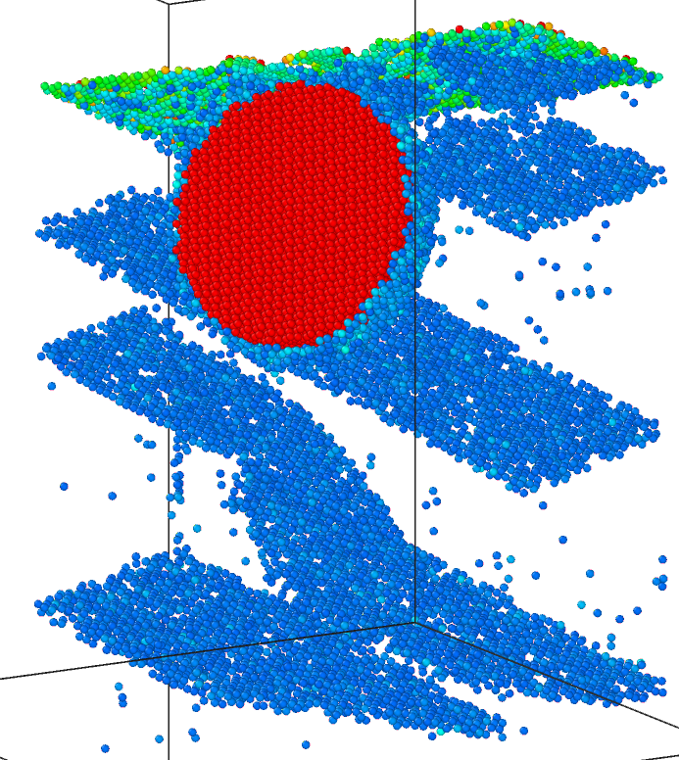
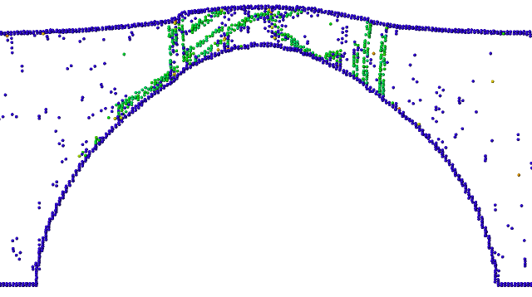
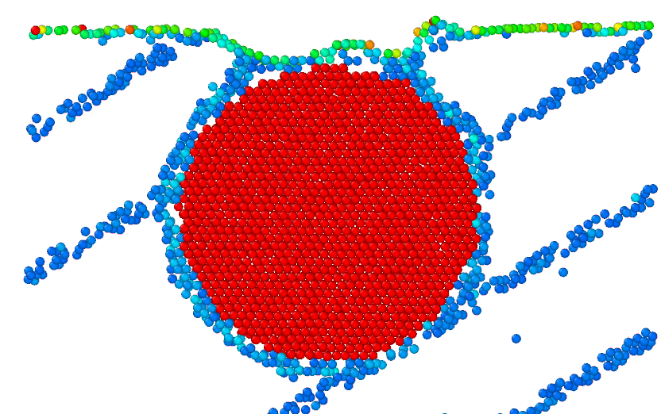
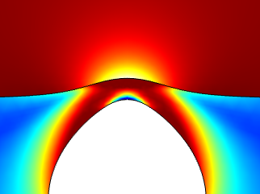
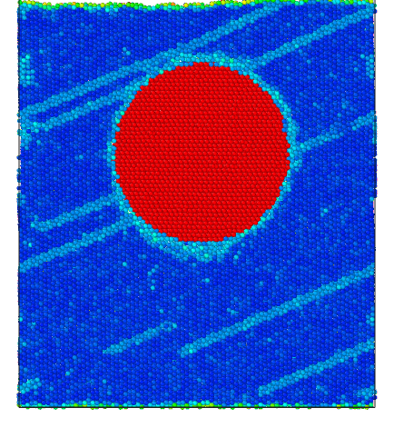
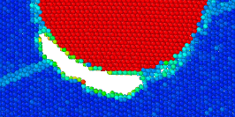
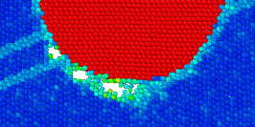

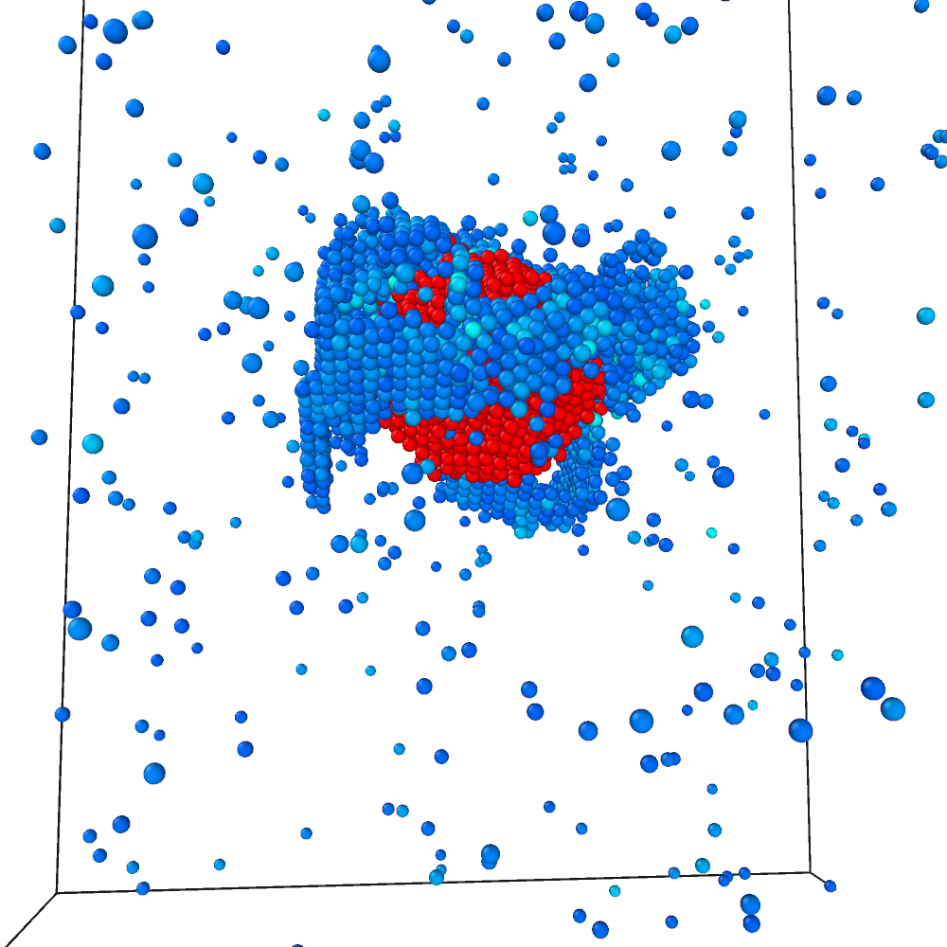

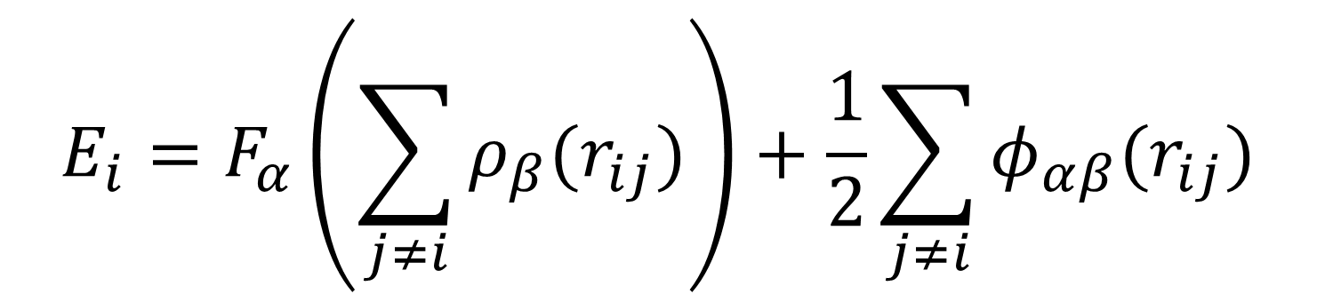
MD Simulations of Fe Precipitates in Cu
Simon Vigonski¹, Vahur Zadin¹, Alvo Aabloo¹, Flyura Djurabekova²
¹ Institute of Technology, University of Tartu
² University of Helsinki
Correspond to: simon.vigonski@ut.ee
Motivation
Setup
Methods
Frequent vacuum break-downs in CLIC accelerating structures are presumably caused by field-enhancing emitters appearing on the surface. The origin of these emitters is hypothesized to be caused by plastic deformations and dislocations [1]. We investigate the effect of voids and precipitates on dislocation nucleation.
Force
h
Classical molecular dy-namics with LAMMPS, using the Bonny et al. many-body EAM poten-tial. [2]
r
Fixed boundary
Fe
z
x
Cu
Box dimensions: 186x193x199 Å
Cu <110> direction in z
Various r and h
$$E_{i}=F_{α}\left(\sum_{j≠i}{ρ_{β}(r_{ij})}\right)+\frac{1}{2}\sum_{j≠i}{φ_{αβ}(r_{ij})}$$
Near-surface voids
Fe precipitates in Cu
Voids near the surface act as stress concentrators in a high external electric field. They are nucleation centers for dislocations that lead to stable protrusions on the surface. [3]
Extensive stacking faults are observed in the presence of large Fe precipitates close to the surface. A depression tends to form on the surface, creating a Cu-Fe-vacuum interface and facilitating atom evaporation.
Stacking faults in Cu around a void from MD simulations [3].
Cu atoms in a perfect lattice not shown.
32 ps at 22.8 GV/m
112 ps at 22.8 GV/m
Stress concentrations in Cu and electric field strength near the surface from FEM simulations.
Continually ramping the electric field was found to create a void below the precipitate. The conditions correspond to a long-lasting or cyclic electric field. FEM simulations show that the stress is highest below the Fe precipitate, explaining the possibility of formation of a void there.
The small voids combine into a large void
E = 30.6 GV/m
Small voids start to form and grow
E = 30.1 GV/m
Irregular precipitates
Inserting Fe as an irregular sphere and relaxing the system causes a knot of Cu stacking faults to form around the precipitate even without an external electric field.
E = 30.0 GV/m
E = 29.8 GV/m
FEM pic here
E = 29.4 GV/m
Conclusions
Precipitates adjacent to the surface facilitate vaporization
Voids can appear below the precipitate under certain conditions.
Irregular precipitates offer more dislocation nucleation sites
Cu atoms in a perfect lattice not shown.
[1] Timko, H., Modelling vacuum arcs : from plasma initiation to surface interactions, Helsinki University Printing House (2011).
[2] Bonny, G., Pasianot, R. C., Castin, N., Malerba, L., Philos. Mag. 89, 3531–3546 (2009).
[3] Pohjonen, A. S., Parviainen, S., Muranaka, T., Djurabekova, F., J. Appl. Phys. 114, 033519 (2013).
This research was supported by the Estonian Science Foundation grant PUT57, CERN+ anything else?

