Slide 1
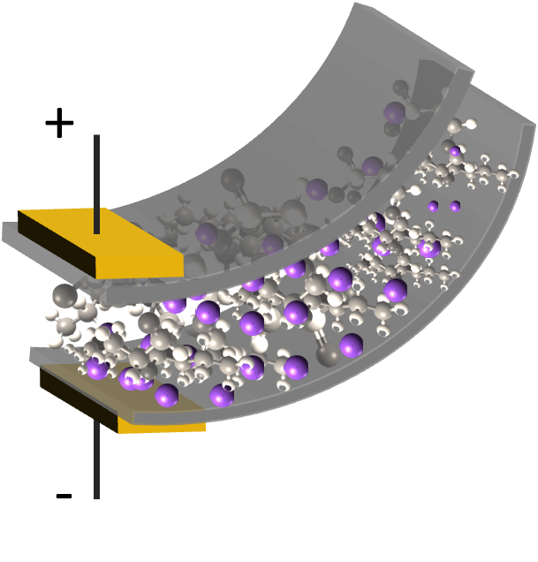
Smart Materials, Adaptive Structures & Intelligent Systems
September 21 – 23, Oxnard, California
Modeling IPMC material with dynamic surface characteristics
David Pugal*#, Alvo Aabloo#,
Kwang J. Kim*, Youngsoo Jung*
*Active Materials and Processing Laboratory (AMPL)
Low Carbon Green Technology Laboratory (LCGTL)
Dept. of Mechanical Engineering
University of Nevada, Reno
#IMS Lab, Institute of Technology, Tartu University, Estonia

Slide 2
Outline
IPMC material
Basic mathematical description of the actuation
Surface electrode model
  Motivation
  Physics background
  Comsol Multiphysics simulations
  Results
Conclusions

Slide 3
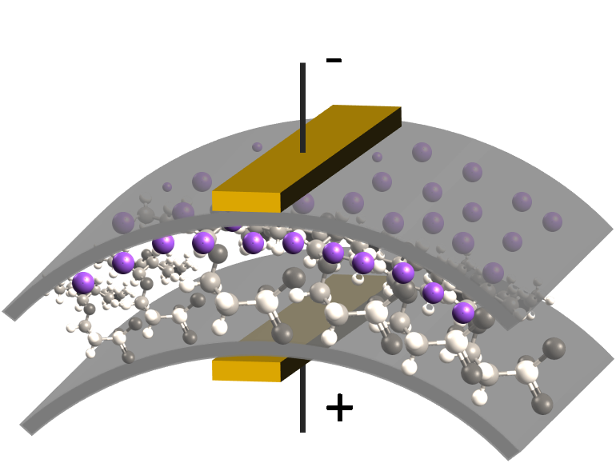
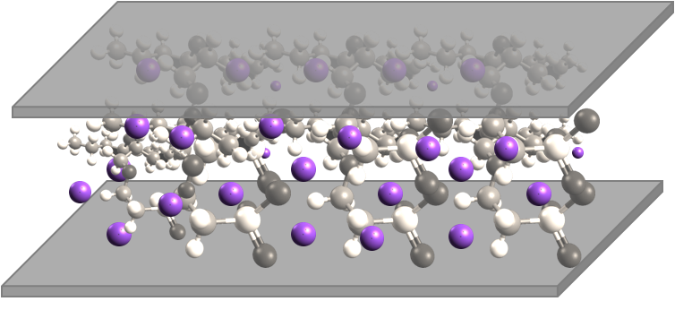
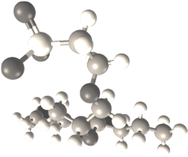
IPMC material
IPMC – Ionic Polymer-Metal Composite
  Electromechanical behavior
  Mechanoelectrical behavior
Nafion™ polymer
Hydrated cation

Slide 4
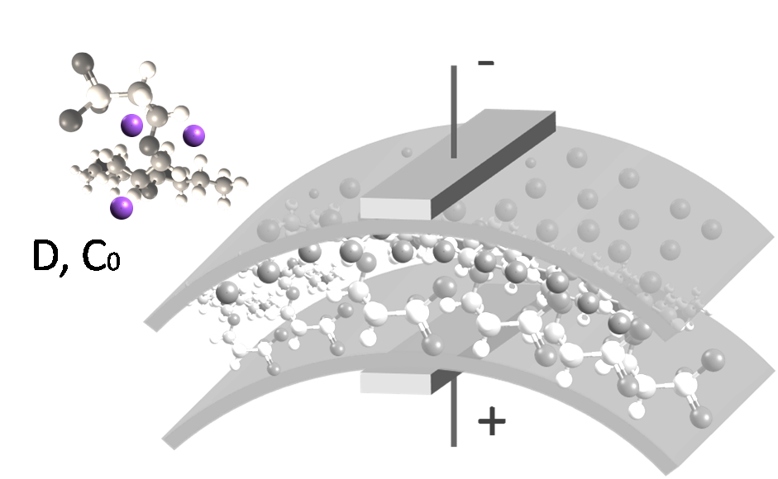
Simple model
The simple physical model:
  Ion migration and diffusion, Nernst-Planck equation
    C – cation concentration
    D – Diffusion coefficient
    z – charge number
    – mobility
    F – Faraday constant
    – electric potential

Slide 5
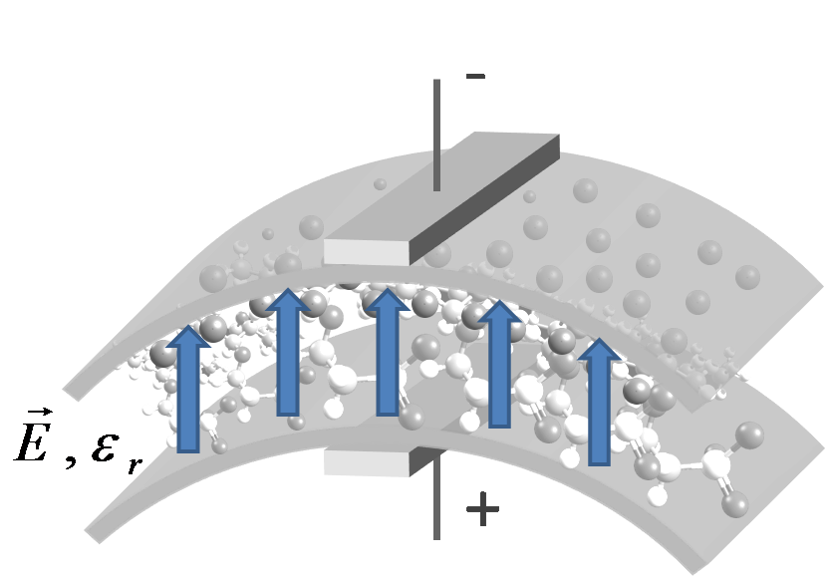
Simple model
The simple physical model:
  Ion migration and diffusion
  Electric field, Poisson’ equation
    Describes the electric field in the IPMC
    E – electric field
    – potential
    – charge density
    – electric permittivity
    F – Faraday constant

Slide 6
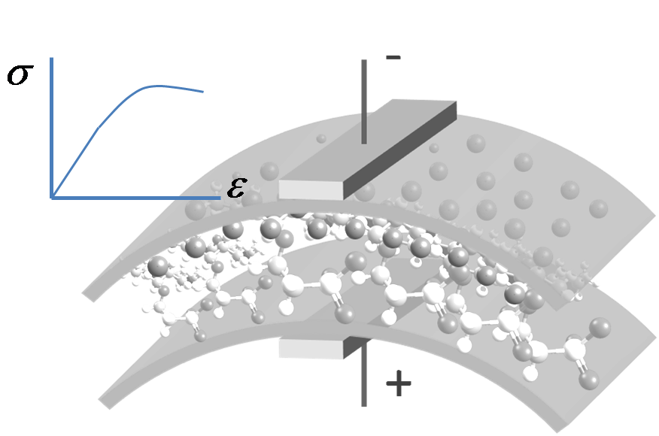
Simple model
The simple physical model:
  Ion migration and diffusion
  Electric field, Poisson’ equation
  Stress-strain
    Stress is related to the charge
    density
  Not considered in this work

Slide 7
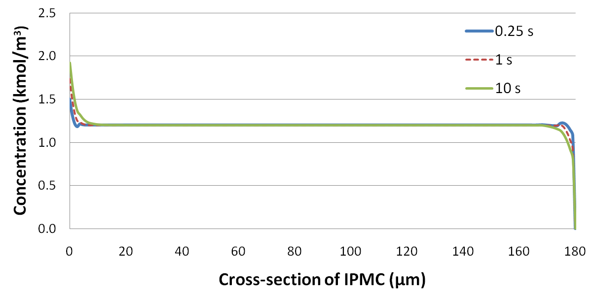
Concentration - Bending
Concentration graph
  Bending related to concentration → electric properties

Slide 8
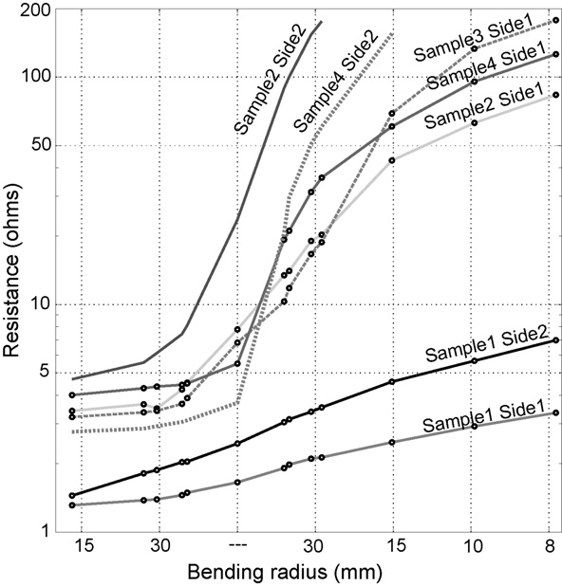
Electrode modeling - Motivation
Modeling the effect of the electrodes on the
potential inside the
polymer. Why?
1)Some samples have
shown significant
dynamic surface
resistance…
A. Punning, M. Kruusmaa and A. Aabloo, Sensors and Actuators, A: Physical 133 (1), 200 (2007).

Slide 9
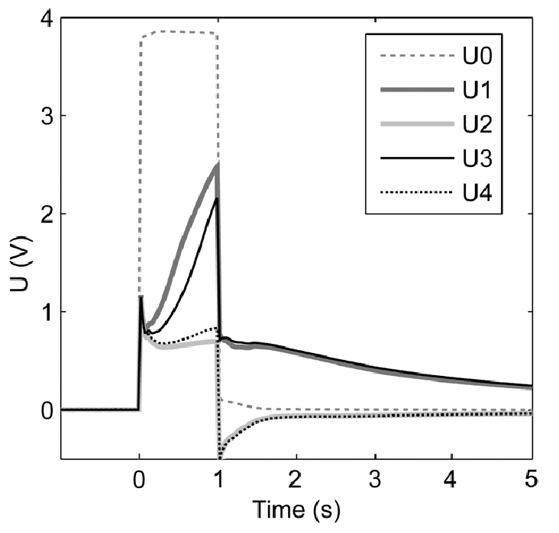
Electrode modeling - Motivation
… which leads to
a voltage drop
along the electrode
  U0, U1, U3 measured on the one side of
  IPMC
  Some of the drop is due to electrolysis
  Part of it is due to
  surface resistance
U0, U1,U3
A. Punning, Dissertation Thesis,
Tartu University, 2007.

Slide 10
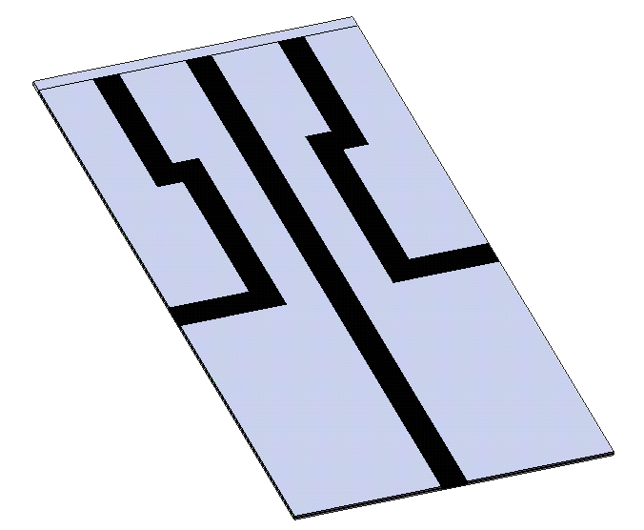
Electrode modeling - motivation
2) Patterned electrodes
  3D bending
  Different areas with different surface
  characteristics
3) Electrode conductivity characterization

Slide 11
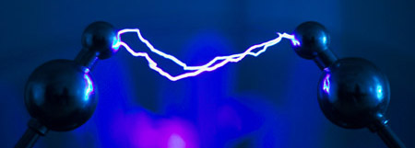
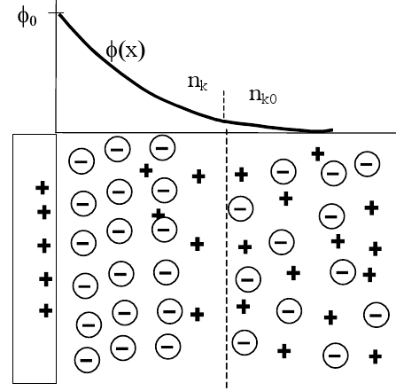
Surface resistance model - background
Tie together the current flowing through the surface
and the ionic current inside the polymer
Ramo-Shockley theorem
  Plasma phycis *
  Ion channels in proteins #
Courtesy of M. Dingemans
* P. Paris, M. Aints, M. Laan, and T. Plank, “Laser-induced current in air gap
at atmospheric pressure,” Journal of Physics D: Applied Physics 38(21),
pp. 3900–3906, 2005.
# W. Nonner, A. Peyser, D. Gillespie, and B. Eisenberg, “Relating Microscopic
Charge Movement to Macroscopic Currents: The Ramo-Shockley Theorem
Applied to Ion Channels,” Biophysical Journal 87(6), pp. 3716–3722, 2004.
Courtesy of M. Laan

Slide 12
Surface resistance model – math.
Current in the external circuit:
By integrating over arbitrary trajectories, the charge:
The following relation for current density
can be derived:
Final form that is used in the
simulations

Slide 13
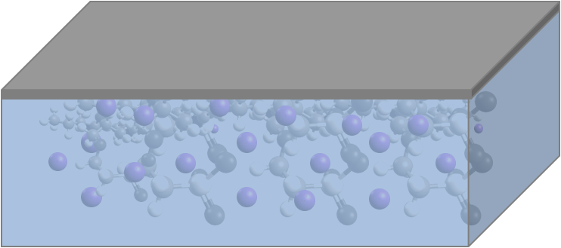
Surface resistance model - Comsol
Implementation in Comsol
  2 different domains are modeled
    1: Polymer (Nernst-Planck and Poisson’ equation)
    2: Electrode (Ohm’ law)
  B.C. Boundary between the bulk Nafion and electrode:
    Integrated ion flux from domain 1 was projected as an input on
    domain 2:
Input voltage
2
1

Slide 14
Surface resistance model - Comsol
The electric current inside the IPMC is calculated by integrating the ion flux
The ion flux is “projected to the electrode” where it becomes a boundary condition for the electrode
model
The voltage of the electrode model, in turn,
becomes a boundary condition to the Poisson
equation, which is responsible for the ion flux
Ion flux
current
electrode b.c
voltage drop

Slide 15
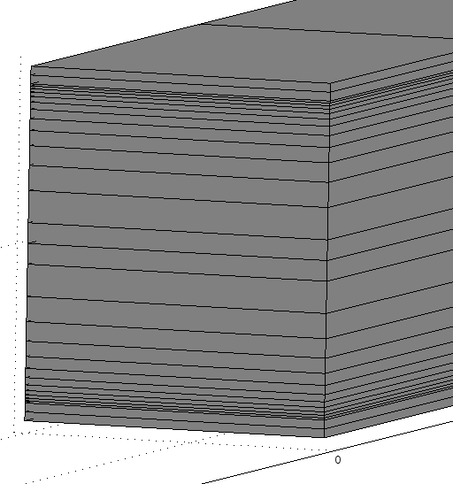
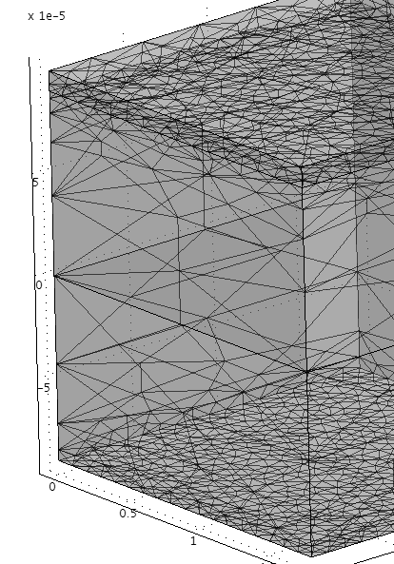
Surface resistance model - Comsol
Implementing in Comsol – meshing
Free mesh – due to projection coupling
(both for 2D and 3D simulations)
Regular mapped mesh - faster

Slide 16

Results
2D modeling – experimental setup
2D modeling – the model
Small area of higher
Surface resistance
-
+
+
-
+
-
Probe 2
P2
Probe 2
Probe 3
Probe 3
p3
Straight IPMC
Bent IPMC

Slide 17
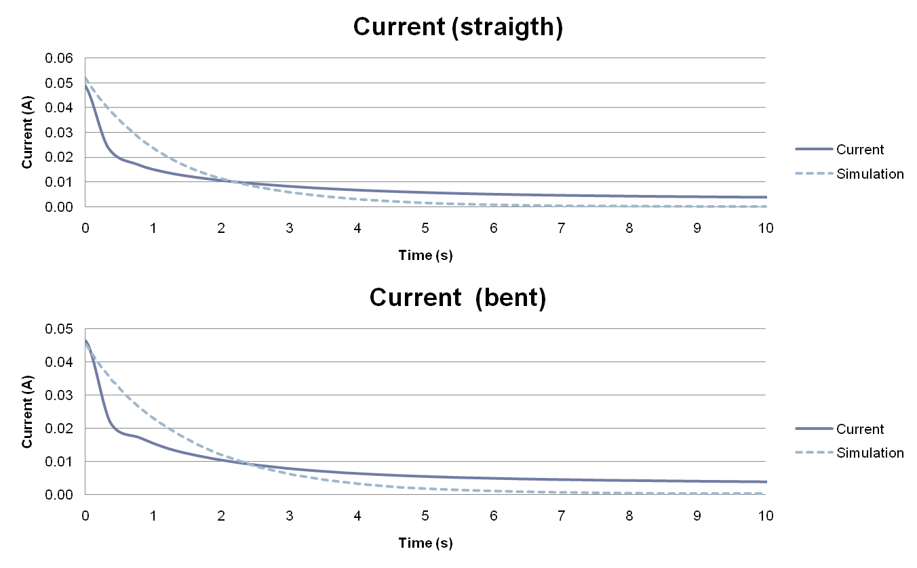
Results – 2D model, current
-
+
+
-

Slide 18
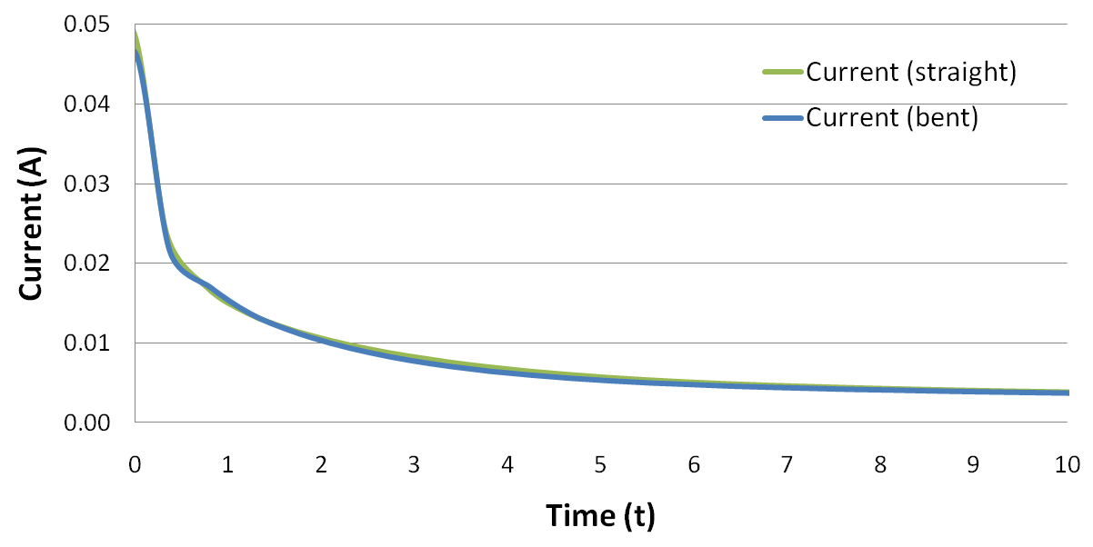
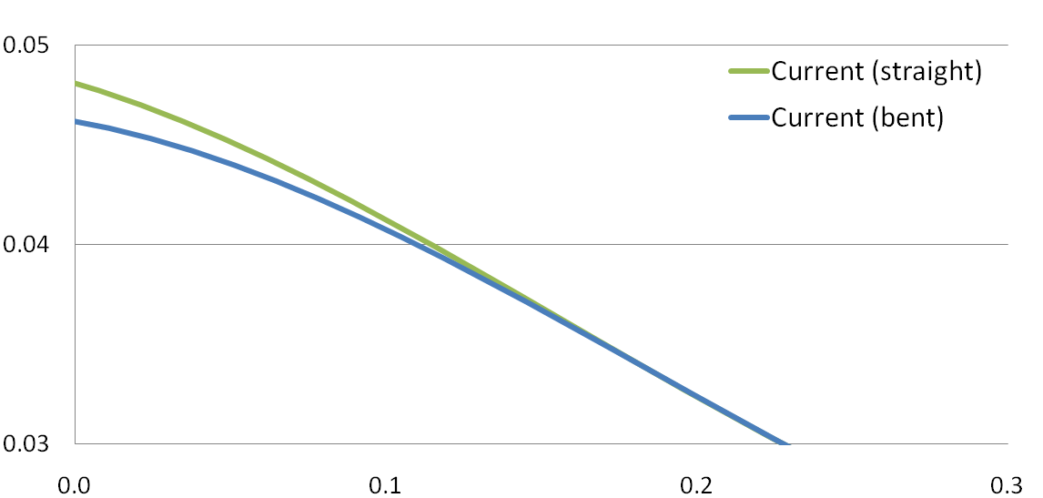
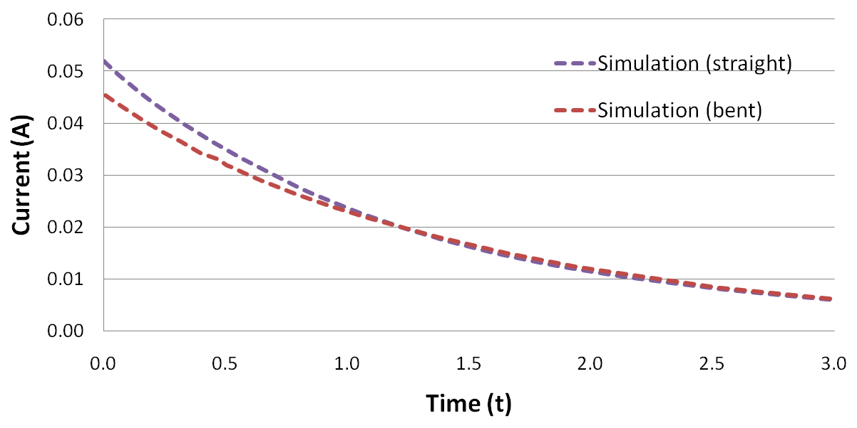
Results – 2D model, current

Slide 19
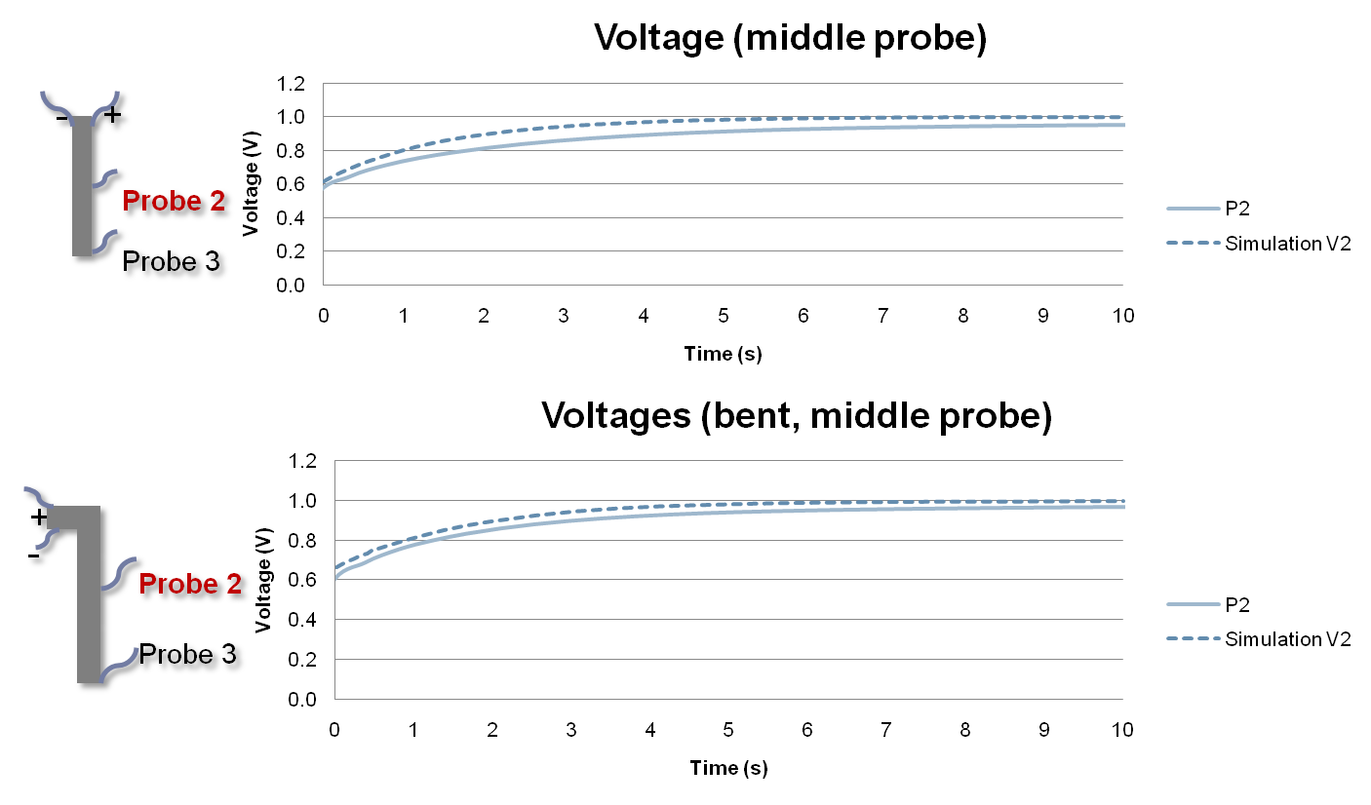
Results – 2D model, Voltage

Slide 20
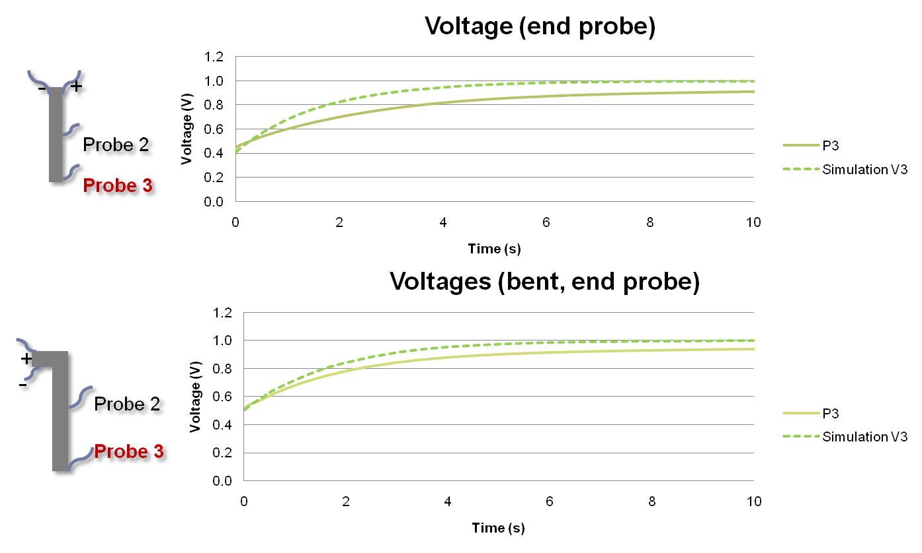
Results – 2D model, Voltage

Slide 21
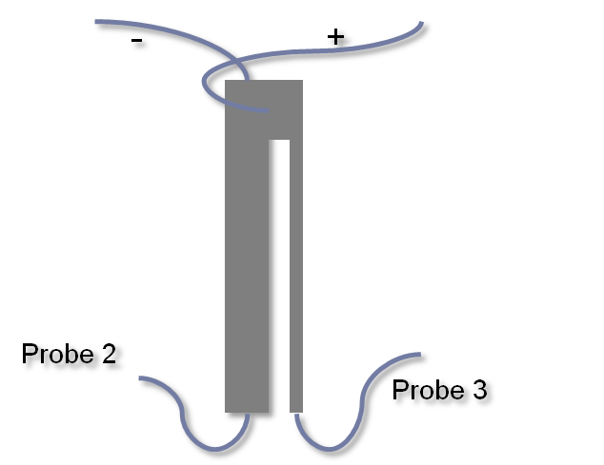
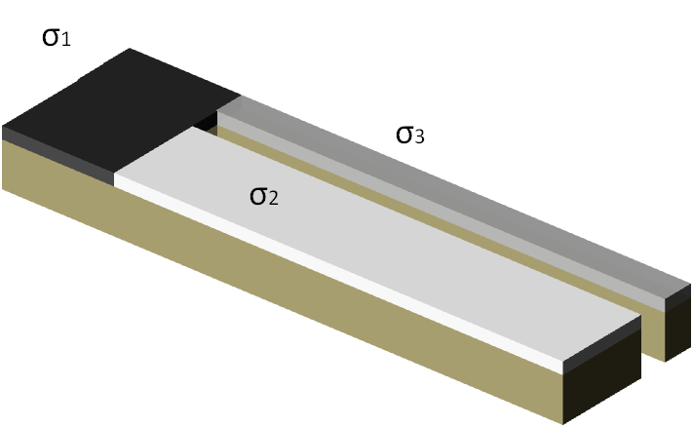
Results
3D modeling – experimental setup
3D modeling – the model
  Scaled model is used!
Top view

Slide 22
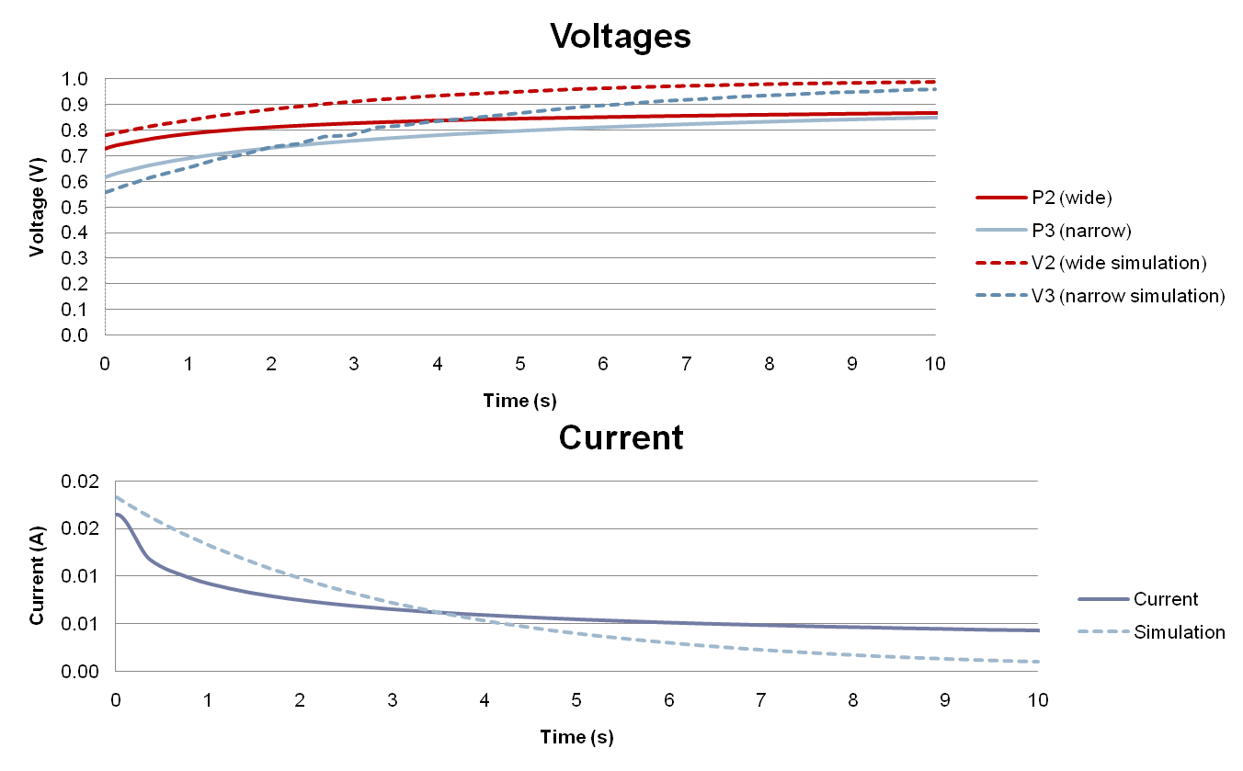
Results – 3D model

Slide 23
Discussion
The results show that the model predictions are correct
  Both electric current and the voltage drop calculations are
  rather realistic
  3D model works as well!
Some downsides of the model
  Time consuming calculation
  The convergence problems due to the feedback nature of
  the model
Possible solutions
  Different solver?
  Use time stepping instead of full time dependent solution
  Simplify the model…

Slide 24
Results – simplifications
Loose the feedback
  Better convergence
  Reduced calculation time
  Ionic current does cause the voltage drop on the electrodes
  The voltage drop does not change the ionic current
  Could be used for characterizing the surface – does not
  change the ionic behavior
Ion flux
current
electrode b.c
voltage drop

Slide 25
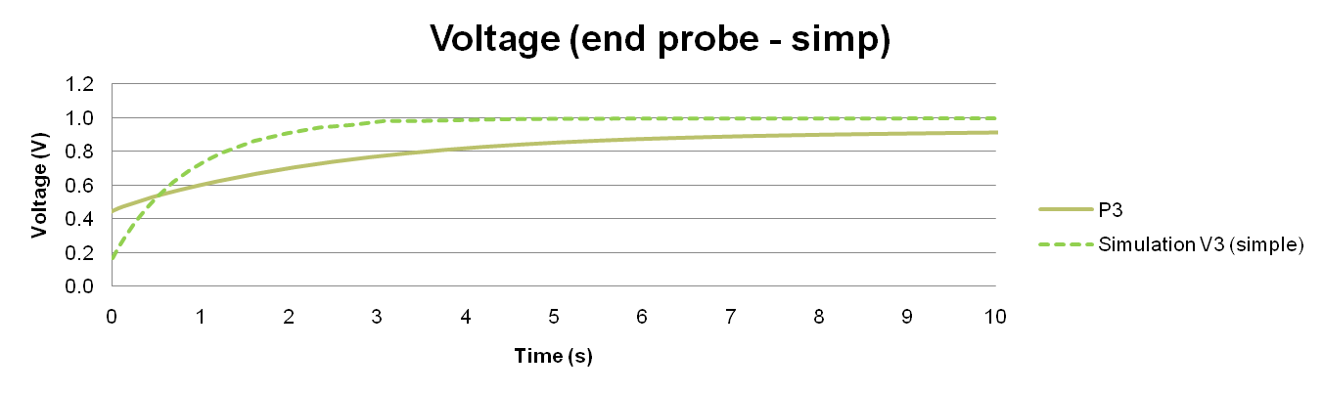
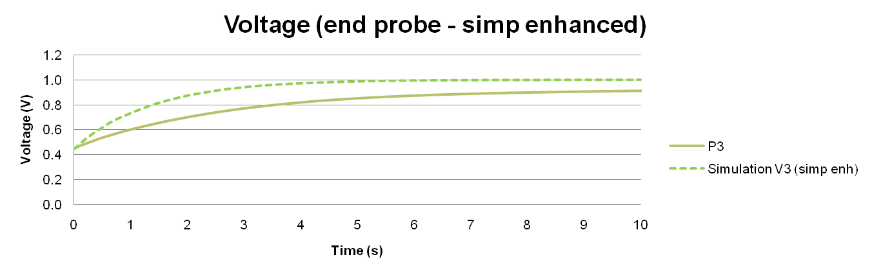
Results – simplified model
Added a factor to
diffusion constant.
Electric current
value is not correct

Slide 26
Conclusions
The surface resistance model works fairly well
The 3D scaled model was developed
  With simple 3D IPMC, the surface could be omitted and the
  full scale model can be used
Using Ramo-Shockley theorem is beneficial,
when the surface resistivity plays important role
  Surface treated IPMCs
  More complicated structures
Future
  Simplify the model, reduce solution time

Slide 27
Acknowledgments
We would like to acknowledge the financial support
from the following organizations:
  U.S. National Science Foundation
  European Science Foundation DoRa programme

Slide 28
Thank you
Questions?

